Slide 1

RV College of Engineering
Dept of Mech. Engg.
Unit 4: Data Analysis
M Krishna

Slide 2
Presentation Agenda
Exploratory Data Analysis,
Statistical Estimation
Hypothesis Testing
Parametric Tests
Non-Parametric Tests
Multiple Regression
Factor Analysis
Cluster Analysis

Slide 3
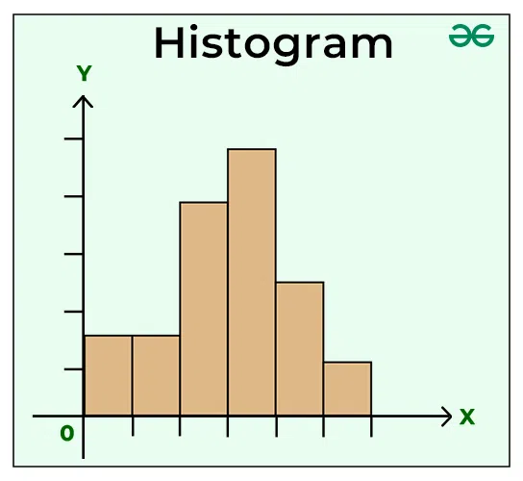
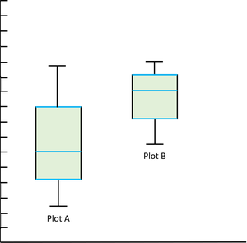
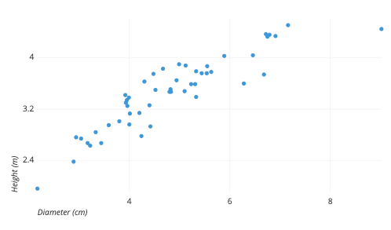
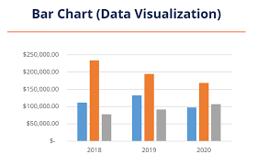
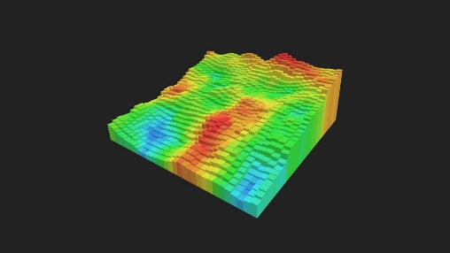
Exploratory Data Analysis
Mechanical Engineering Department
The Goal of data analysis is to gain information from data.
Exploratory Data Analysis: is a crucial step in data analysis that involves summarizing and visualizing the key characteristics of a dataset
Methods of Exploratory data Analysis
Descriptive Statistics: Summarize the central tendency, dispersion, and shape of the dataset’s distribution using mean, median, mode, variance, and standard deviation.
Data Visualization: Use graphical tools to understand the data better. Common plots include (Histograms, Box Plots, Scatter Plots, Bar Charts, Heatmaps)

Slide 4
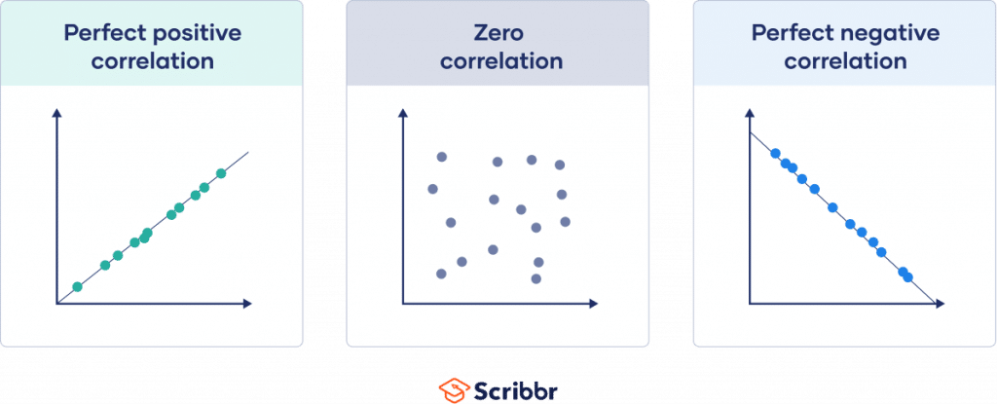
Methods of EDA
Mechanical Engineering Department
Data Cleaning: Identify and handle missing values, outliers, and inconsistencies in the data
Correlation Analysis: Examine the relationships between variables using correlation coefficients and scatter plots.

Slide 5
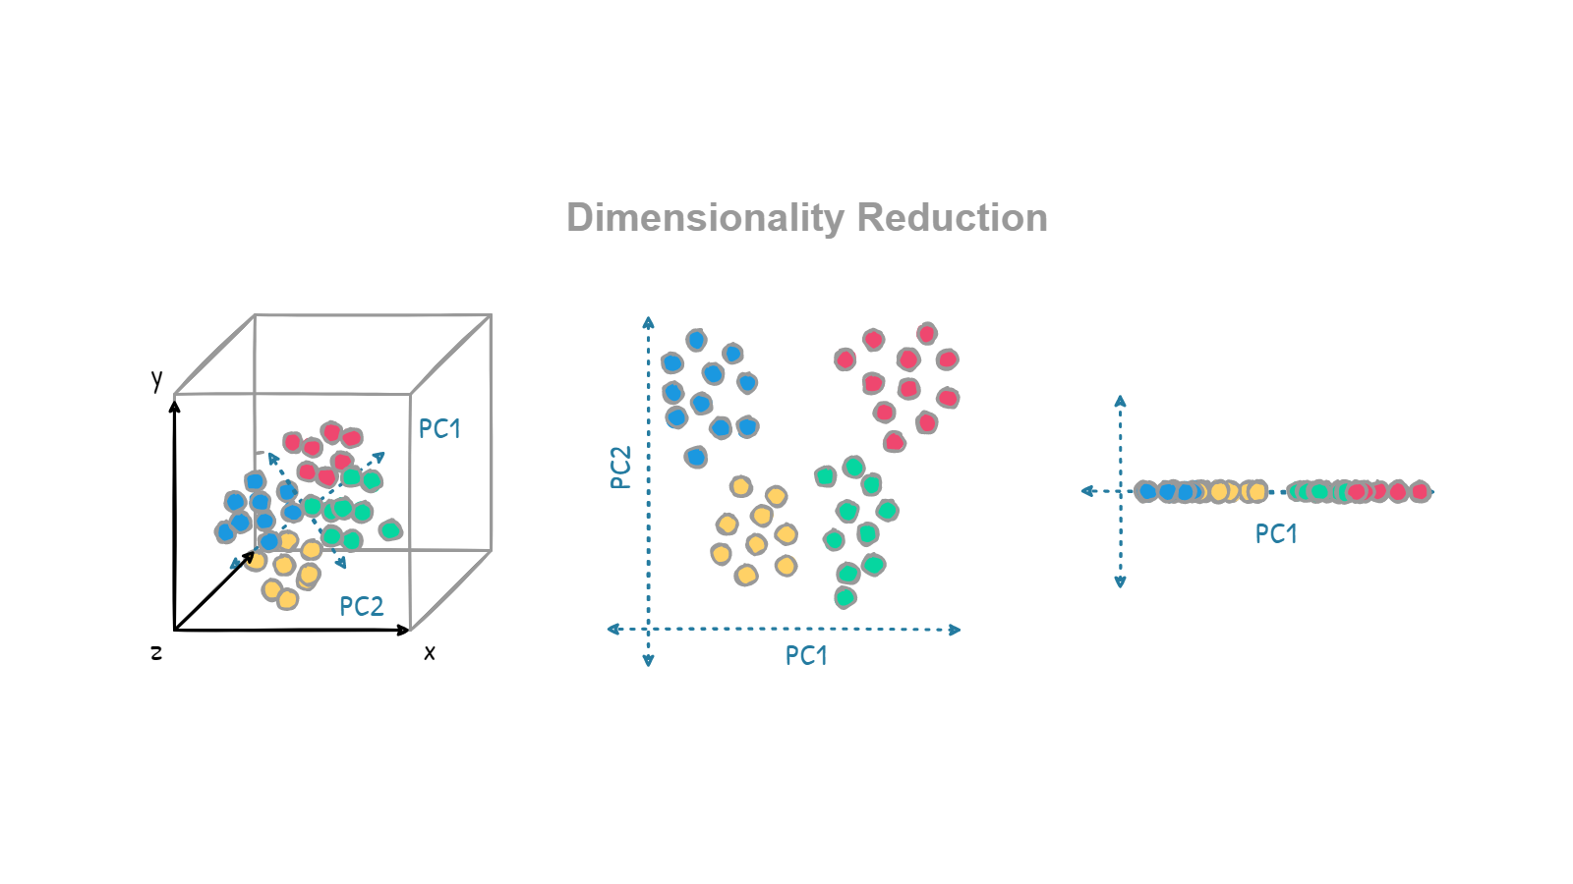
Methods of EDA
Mechanical Engineering Department
Dimensionality Reduction: Use techniques like Principal Component Analysis (PCA) to reduce the number of variables while retaining essential information.

Slide 6
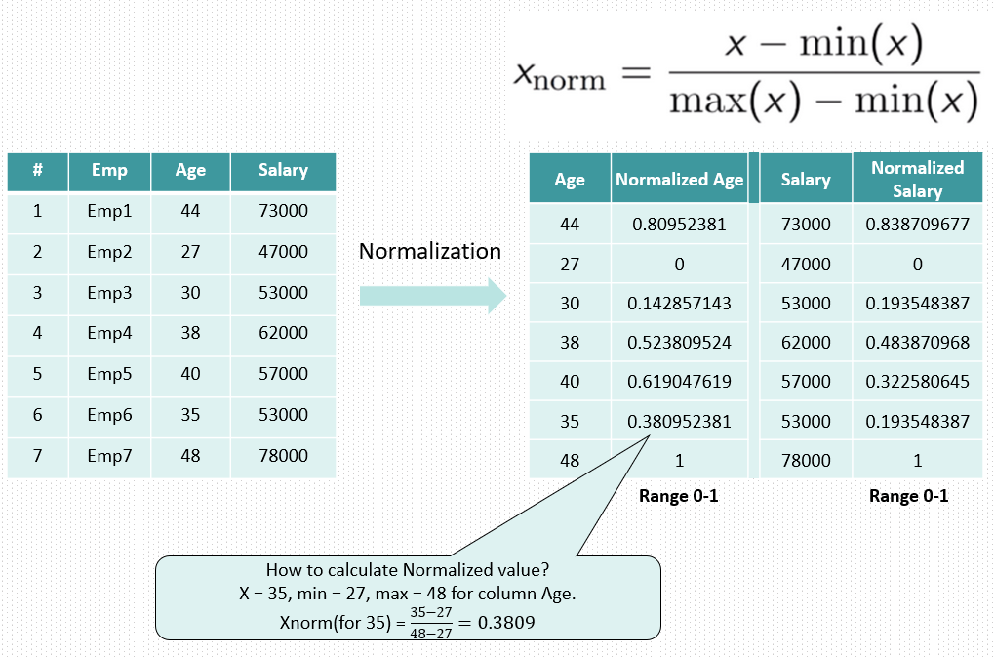
Methods of EDA
Mechanical Engineering Department
Data Transformation: Apply transformations to make the data more suitable for analysis, such as normalization or scaling.

Slide 7
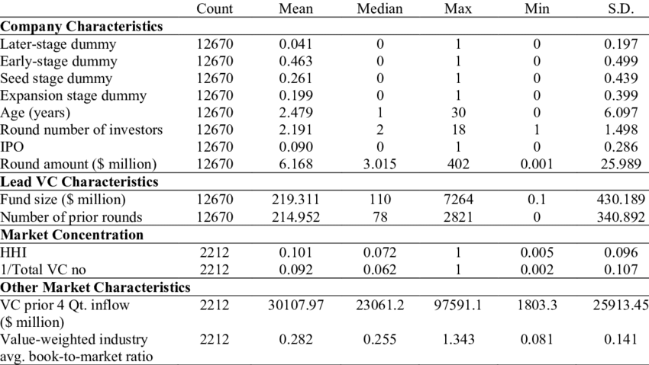
Methods of EDA
Mechanical Engineering Department
Summary Statistics: Look at aggregate statistics to understand the overall patterns and trends in the data
Exploration of Data Subsets: Analyze specific subsets of the data to uncover more detailed patterns or differences.

Slide 8

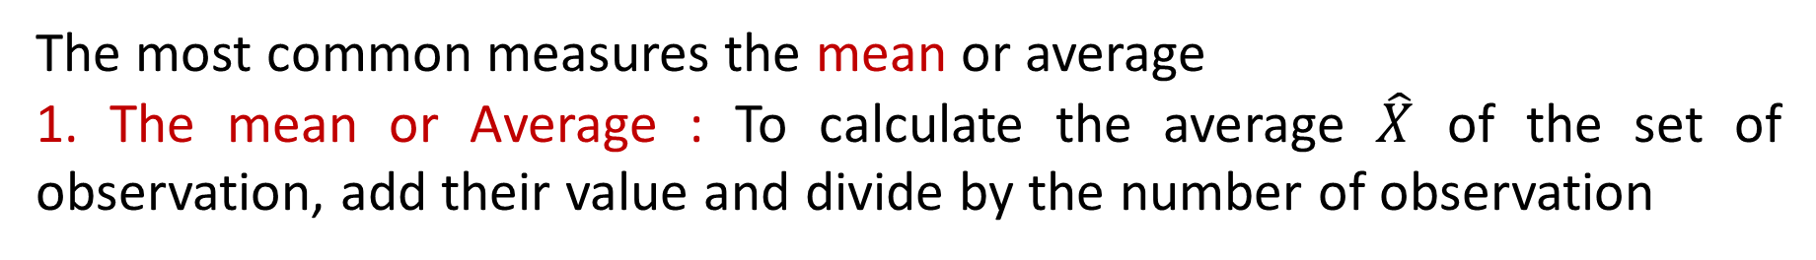
Data Distribution: Mean
Mechanical Engineering Department
The most common measures the mean or average
1. The mean or Average : To calculate the average $\hat{X}$ of the set of observation, add their value and divide by the number of observation
Let the mean of x₁, x₂, x₃ ……x_{n} be A, then what is the mean of:
1. (x₁+k) ,(x₂+k), (x₃+k), ……(x_{n}+k)? Mean= A+K
2. (x₁-k) ,(x₂-k), (x₃-k), ……(x_{n}-k)? Mean = A-K
3. kx₁, kx₂, kx₃ ……kx_{n}? Mean = AK
If the heights of 5 people are 142 cm, 150 cm, 149 cm, 156 cm and 153 cm. Find the mean height.
Mean height = $\frac{142+150+149+156+153}{5}$ =150

Slide 9
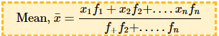
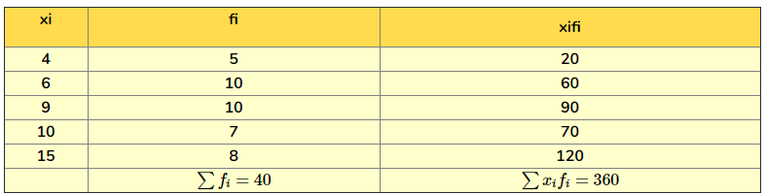
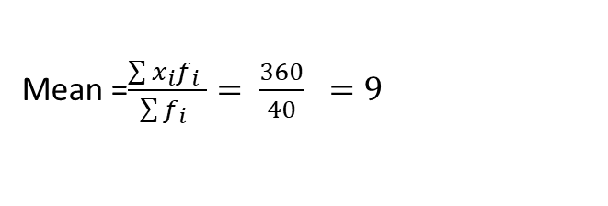
Data Distribution: Mean
Mechanical Engineering Department
Find the mean of the following distribution
Mean =$\frac{\sum{x_{i}f_{i}} }{\sum{f_{i}} }= \frac{360}{40} =9$

Slide 10
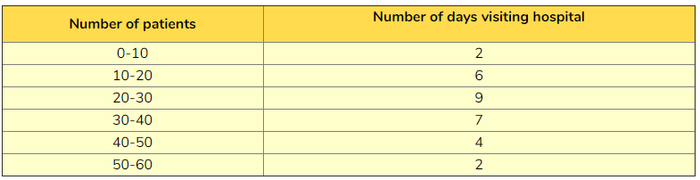
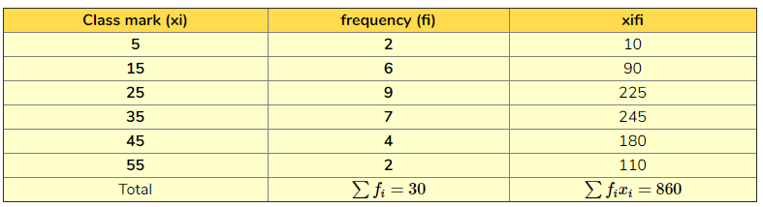
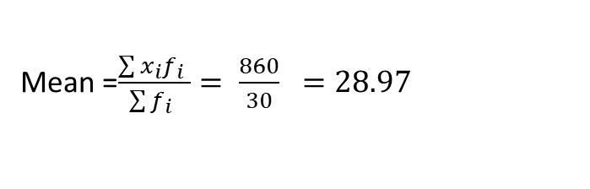
Data Distribution: Mean
Mechanical Engineering Department
Find the average number of patients visiting the hospital in a day.
Mean =$\frac{\sum{x_{i}f_{i}} }{\sum{f_{i}} }= \frac{860}{30} =28.97$

Slide 11
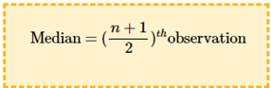
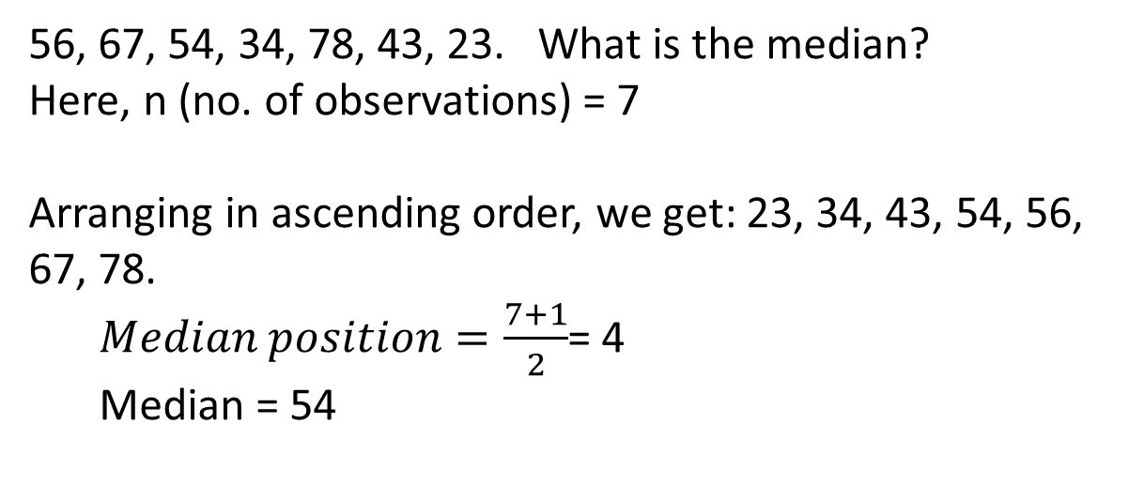
Data Distribution: Median
Mechanical Engineering Department
The median M is the midpoint of a distribution, the number such that half the observations are smaller, and the other half are larger.
To Find the Median
Sort all the observation in order of size from smallest to largest
It the number of observations n is odd, the median M is the centre observation in the ordered ist e.g. M = n+1/2 the obs.
It the number of observations n is even, the mean of two centre observation in the ordered list
Median (odd numbers)
56, 67, 54, 34, 78, 43, 23. What is the median?
Here, n (no. of observations) = 7
Arranging in ascending order, we get: 23, 34, 43, 54, 56, 67, 78.
$Median position=\frac{7+1}{2}$= 4
Median = 54

Slide 12
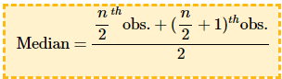
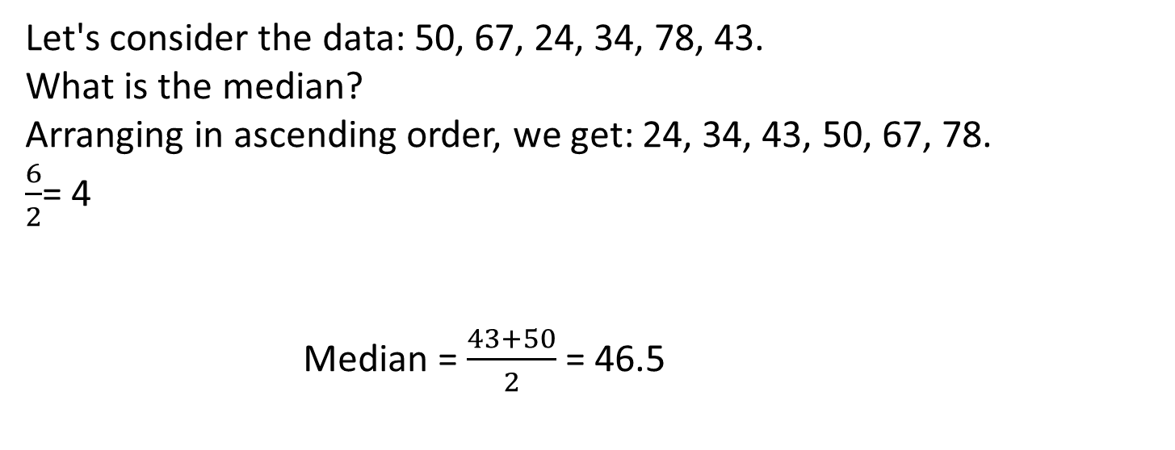
Data Distribution: Median
Mechanical Engineering Department
Median (even)
Let's consider the data: 50, 67, 24, 34, 78, 43.
What is the median?
Arranging in ascending order, we get: 24, 34, 43, 50, 67, 78.
$\frac{6}{2}$= 4
Median = $\frac{43+50}{2}$ = 46.5

Slide 13
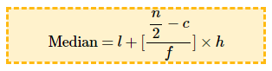
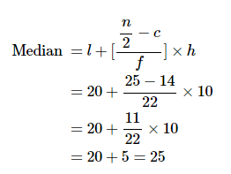
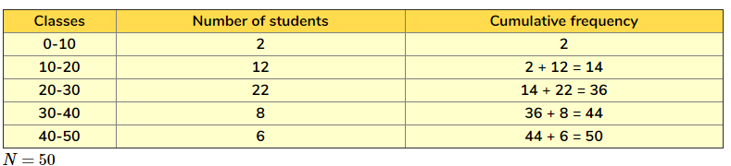
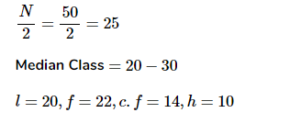
Data Distribution: Median (Grouped data)
Mechanical Engineering Department
where,
l=lower limit of median class
c= cumulative frequency of the class preceding the median class
f=frequency of the median class
H =class size
n is total number of observation i.e f
Find the median marks for the following distribution:

Slide 14
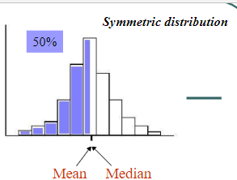
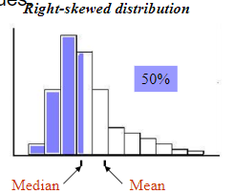
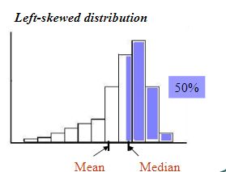
Mean versus Median
Mechanical Engineering Department
The Mean and median of a symmetric distribution are close together
In Skewed distributions, the mean is father out in the long tail than is the median. The mean is more sensitive to extreme values.

Slide 15
Mean or Median
Mechanical Engineering Department
The mean is a good measure for the centre of a symmetric distribution
The median is a resistant measure and should be used for skewed distributions.
Its value is only slightly affected by the presence of extreme observations, no matter how large these observations are.

Slide 16
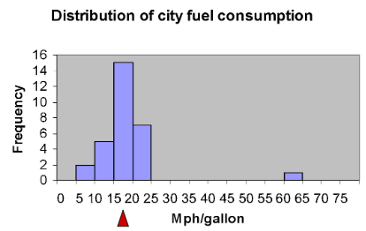
The Mode
Mechanical Engineering Department
The Mode is the observation value with the highest frequency (observation with maximum frequency
An average, the cars under study drive 18.9 miles per gallon, and 50% of cars under study drive at least 18 miles per gallon

Slide 17
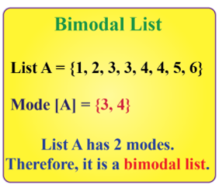
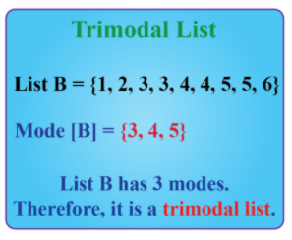
The Mode
Mechanical Engineering Department
6, 8, 9, 3, 4, 6, 7, 6, 3 the value 6 appears the most number of times.
Thus, mode = 6.

Slide 18
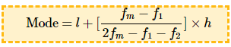
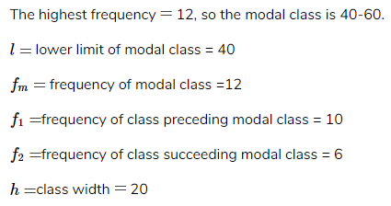
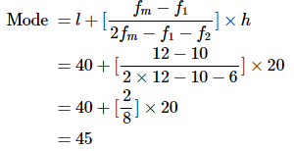
The Mode for grouped data
Mechanical Engineering Department
where, l= lower limit of modal class,
f_{m}= frequency of modal class,
f₁= frequency of class preceding modal class,
f₂= frequency of class succeeding modal class,
h= class width
Find the mode of the given data:

Slide 19
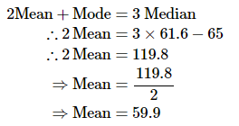
Mechanical Engineering Department
The relation between Mean, Median and Mode
2 mean + Mode = 3 Median
We have a data whose mode == 65 and median == 61.6. Find Mean

Slide 20
Spread of a Distribution
Mechanical Engineering Department
Quartiles are statistical measures that divide a dataset into four equal parts, each representing 25% of the data. .
First Quartile (Q1): Also known as the lower quartile, it represents the 25th percentile of the data.
Second Quartile (Q2): This is the median of the dataset and represents the 50th percentile. It divides the dataset into two equal halves.
Third Quartile (Q3): Also known as the upper quartile, it represents the 75th percentile of the data. This means that 75% of the data values fall below Q3.
Interquartile Range (IQR): This is the range between the first and third quartiles (Q3 - Q1). The IQR measures the spread of the middle 50% of the data and is used to identify outliers.

Slide 21
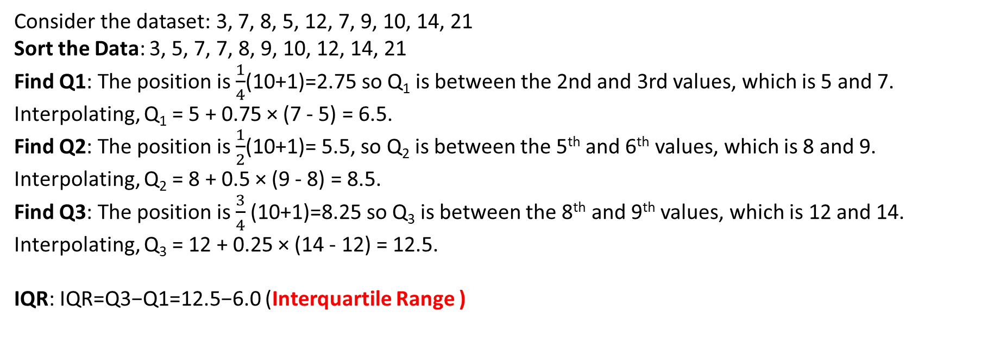
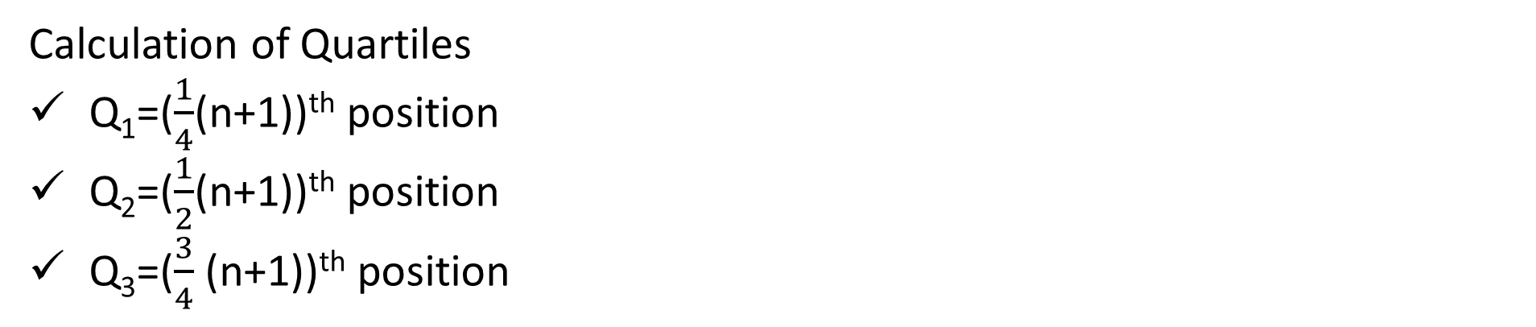
Spread of a Distribution
Mechanical Engineering Department
Calculation of Quartiles
Q₁=($\frac{1}{4}$(n+1))^{th} position
Q₂=($\frac{1}{2}$(n+1))^{th} position
Q₃=($\frac{3}{4}$​(n+1))^{th} position
n is the number of data points
Consider the dataset: 3, 7, 8, 5, 12, 7, 9, 10, 14, 21
Sort the Data: 3, 5, 7, 7, 8, 9, 10, 12, 14, 21
Find Q1: The position is $\frac{1}{4}$(10+1)=2.75 so Q₁ is between the 2nd and 3rd values, which is 5 and 7. Interpolating, Q₁ = 5 + 0.75 × (7 - 5) = 6.5.
Find Q2: The position is $\frac{1}{2}$(10+1)= 5.5, so Q₂ is between the 5th and 6th values, which is 8 and 9. Interpolating, Q₂ = 8 + 0.5 × (9 - 8) = 8.5.
Find Q3: The position is $\frac{3}{4}$(10+1)=8.25 so Q₃ is between the 8th and 9th values, which is 12 and 14. Interpolating, Q₃ = 12 + 0.25 × (14 - 12) = 12.5.
IQR: IQR=Q3−Q1=12.5−6.0 (Interquartile Range )

Slide 22
Spread of a Distribution
Mechanical Engineering Department
Find Interquartile Range of 5 ,6, 1, 2, 15, 12, 27, 19, 18 (Odd numbers)
Step 1: Put the numbers in order. 1, 2, 5, 6, 7, 9, 12, 15, 18, 19, 27.
Step 2: Find the median. 1, 2, 5, 6, 7, 9, 12, 15, 18, 19, 27.
Step 3: Place parentheses around the numbers above and below the median. Not necessary statistically, but it makes Q1 and Q3 easier to spot. (1, 2, 5, 6, 7), 9, (12, 15, 18, 19, 27).
Step 4: Find Q1 and Q3 (Think of Q1 as a median in the lower half of the data and think of Q3 as a median for the upper half of data.) (1, 2, 5, 6, 7), 9, ( 12, 15, 18, 19, 27). Q1 = 5 and Q3 = 18.
Step 5: Subtract Q1 from Q3 to find the interquartile range. 18 – 5 = 13.

Slide 23
Spread of a Distribution
Mechanical Engineering Department
Find Interquartile Range of 4,4,10,11,15,7,14,12,6(Odd numbers)
Step 1: Put the numbers in order. 4,4,6,7,10,11,12,14,15
Step 2: Find the median. 4,4,6,7,10,11,12,14,15
Step 3: Place parentheses around the numbers above and below the median. Not necessary statistically, but it makes Q1 and Q3 easier to spot. (4,4,6,7), 10, (11,12,14,15).
Step 4: Find Q1 and Q3
(4,4,6,7), 10, (11,12,14,15). Q1 = 5 and Q3 = 13.
Step 5: Subtract Q1 from Q3 to find the interquartile range. 13 – 5 = 8.

Slide 24
Spread of a Distribution
Mechanical Engineering Department
Find the IQR for the following data set: 3, 5, 7, 8, 9, 11, 15, 16, 20, 21 (Even)
Step 1: Put the numbers in order: 3, 5, 7, 8, 9, 11, 15, 16, 20, 21.
Step 2: Make a mark in the centre of the data: 3, 5, 7, 8, 9, | 11, 15, 16, 20, 21.
Step 3: Place parentheses around the numbers above and below the mark you made in Step 2–it makes Q1 and Q3 easier to spot. (3, 5, 7, 8, 9), | (11, 15, 16, 20, 21).
Step 4: Find Q1 and Q3 Q1 is the median (the middle) of the lower half of the data, and Q3 is the median (the middle) of the upper half of the data. (3, 5, 7, 8, 9), | (11, 15, 16, 20, 21). Q1 = 7 and Q3 = 16.
Step 5: Subtract Q1 from Q3. 16 – 7 = 9.

Slide 25
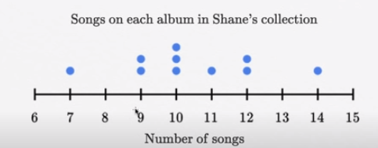
Spread of a Distribution
Mechanical Engineering Department
Step 1: Put the numbers in order. 7,9,9,10,10,10,11,12,12,14
Step 2: Make a mark in the centre of the data: 7,9,9,10,10|10,11,12,12,14
Step 3: Place parentheses around the numbers above and below the mark you made in Step 2–it makes Q1 and Q3 easier to spot. (7,9,9,10,10), | (10,11,12,12,14).
Step 4: Find Q1 and Q3 (7,9,9,10,10), | (10,11,12,12,14). Q1 = 9 and Q3 = 12.
Step 5: Subtract Q1 from Q3. 12 – 9 = 3.

Slide 26
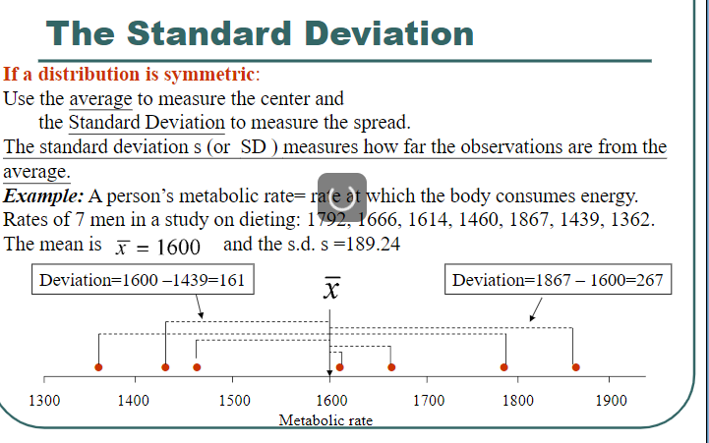
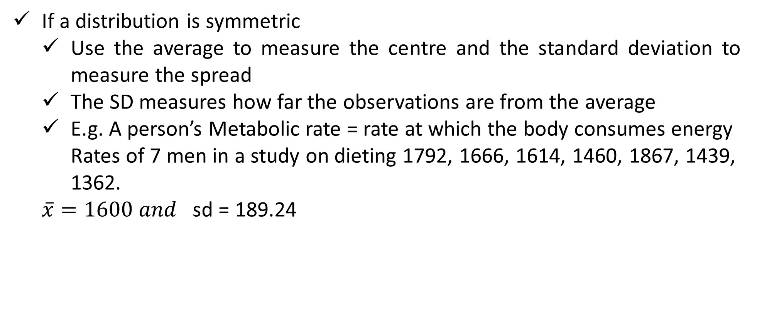
Standard Deviation
Mechanical Engineering Department
If a distribution is symmetric
Use the average to measure the centre and the standard deviation to measure the spread
The SD measures how far the observations are from the average
E.g. A person’s Metabolic rate = rate at which the body consumes energy Rates of 7 men in a study on dieting 1792, 1666, 1614, 1460, 1867, 1439, 1362.
$\overline{x}=1600 and$ sd = 189.24

Slide 27
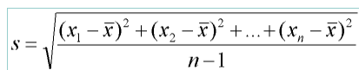
Standard Deviation
Mechanical Engineering Department
‘the variance of an observed Variables is defined as the square of the standard deviation
Variance = s²
Properties of Standard Deviation
It measures the spread about the mean
Only used in association with the mean, Good descriptive measure for Symmetric distributions
If s = 0 all observations have the same values
It is NOT a resistant measure, a few extreme observations may affect its values

Slide 28
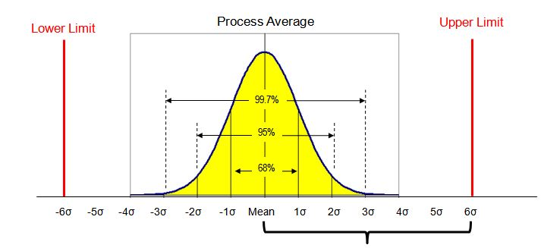
Interpreting the SD
Mechanical Engineering Department
For many lists of observation- especially if their histogram is bell-shaped
Roughly 6* % of the observation in the list lie within 1 SD of the average
95% of the observation lie within 2 SD of the average
Sigma | Defects | Confidence
1S | 31.8% | 68%
2S | 6.7% | 95%
3S | 2.7% | 99.7%
4S | 0.6% | 99.99%
5S | 0.02%
6S | 0.00034%

Slide 29
Problems
Mechanical Engineering Department
Consider the following three data sets A, B and C and determine standard Deviation
A = {9,10,11,7,13} B = {10,10,10,10,10} C = {1,1,10,19,19}
Step 1: Mean
Mean of Data set A = (9+10+11+7+13)/5 = 10 Mean of Data set B = (10+10+10+10+10)/5 = 10 Mean of Data set C = (1+1+10+19+19)/5 = 10
Standard Deviation Data set A = √[ ( (9-10)²+(10-10)²+(11-10)²+(7-10)²+(13-10)² )/5 ] = 2
Standard Deviation Data set B= √[ ( (10-10)²+(10-10)²+(10-10)²+(10-10)²+(10-10)² )/5 ] = 0 Standard Deviation Data set C = √[ ( (1-10)²+(1-10)²+(10-10)²+(19-10)²+(19-10)² )/5 ] = 8.05
Variance = S² Coefficient of Variance = CV = standard deviation / Mean
Variance of A = 2² =4 CV of A = 2/10 = 0.2
Variance of B = 0² = 0 CV of B = 0/10 = 0
Variance of C = 8² =64 CV of C = 8.05/10 = 0.805

Slide 30
Problems
Mechanical Engineering Department
Consider the following three data sets A, B and C and determine standard Deviation
A = {9,10,11,7,13} B = {10,10,10,10,10} C = {1,1,10,19,19}
Step 1: Mean
Mean of Data set A = (9+10+11+7+13)/5 = 10 Mean of Data set B = (10+10+10+10+10)/5 = 10 Mean of Data set C = (1+1+10+19+19)/5 = 10
Standard Deviation Data set A = √[ ( (9-10)²+(10-10)²+(11-10)²+(7-10)²+(13-10)² )/5] = 2
Standard Deviation Data set B= √[ ( (10-10)²+(10-10)²+(10-10)²+(10-10)²+(10-10)² )/5 ] = 0 Standard Deviation Data set C = √[ ( (1-10)²+(1-10)²+(10-10)²+(19-10)²+(19-10)² )/5 ] = 8.05
Variance = S² Coefficient of Variance = CV = standard deviation / Mean
Variance of A = 2² =4 CV of A = 2/10 = 0.2
Variance of B = 0² = 0 CV of B = 0/10 = 0
Variance of C = 8² =64 CV of C = 8.05/10 = 0.805

Slide 31
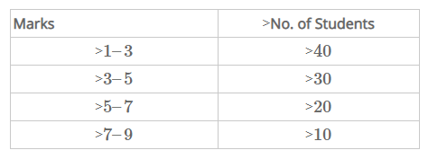
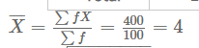
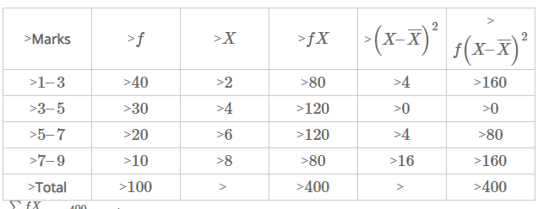
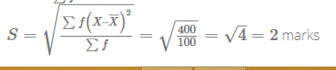
Interpreting the SD
Mechanical Engineering Department
Calculate the standard deviation from the following distribution of marks by using all the methods.
Variance = S² = 4
CV= S/x = 2/4 = 0.5

Slide 32
Statistical Estimation
Mechanical Engineering Department
Parameter: A numerical characteristic of a population, such as the mean (μ) or standard deviation (σ)
Estimator: A statistic (a function of the sample data) used to estimate a population parameter.
Estimate: The value obtained from an estimator. For instance, if the sample mean is 50, then 50 is the estimate of the population mean.
Point Estimate: A single value given as an estimate of a population parameter. For example, using the sample mean to estimate the population mean.
Interval Estimate: A range of values within which the population parameter is expected to lie, with a certain level of confidence. For example, a 95% confidence interval for the mean.

Slide 33
Mechanical Engineering Department
Factors Affecting Confidence Interval Estimates
The factors that determine the width of a confidence interval are
The sample size, n
The variability in the population, usually SD estimated
The desired level of confidence

Slide 34
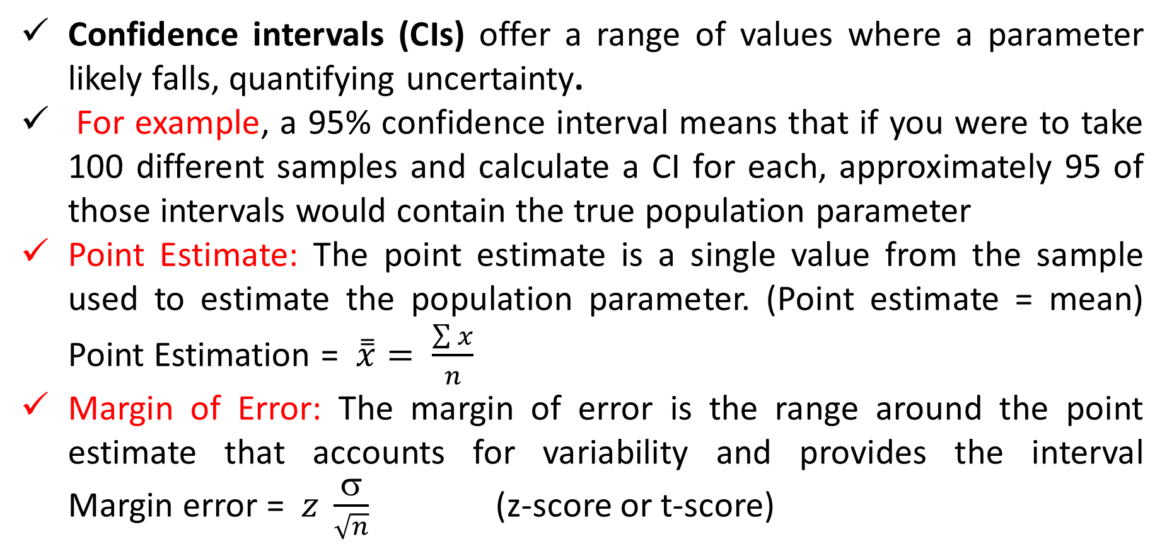
Confidence Intervals
Mechanical Engineering Department
Confidence intervals (CIs) offer a range of values where a parameter likely falls, quantifying uncertainty.
For example, a 95% confidence interval means that if you were to take 100 different samples and calculate a CI for each, approximately 95 of those intervals would contain the true population parameter
Point Estimate: The point estimate is a single value from the sample used to estimate the population parameter. (Point estimate = mean) Point Estimation = $\overset{̿}{x}= \frac{\sum{x}}{n}$
Margin of Error: The margin of error is the range around the point estimate that accounts for variability and provides the interval Margin error = $z \frac{σ}{\sqrt{n}}$ (z-score or t-score)

Slide 35
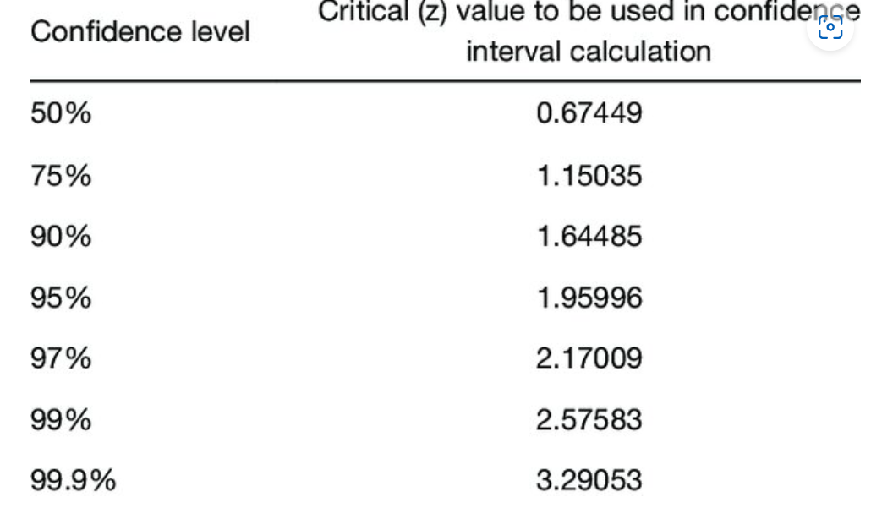

Confidence Intervals
Mechanical Engineering Department
Confidence intervals (CIs)
Confidence Interval for the Mean (known σ and z distribution)
μ = $\breve{x} ± z \frac{σ}{\sqrt{n}}$

Slide 36

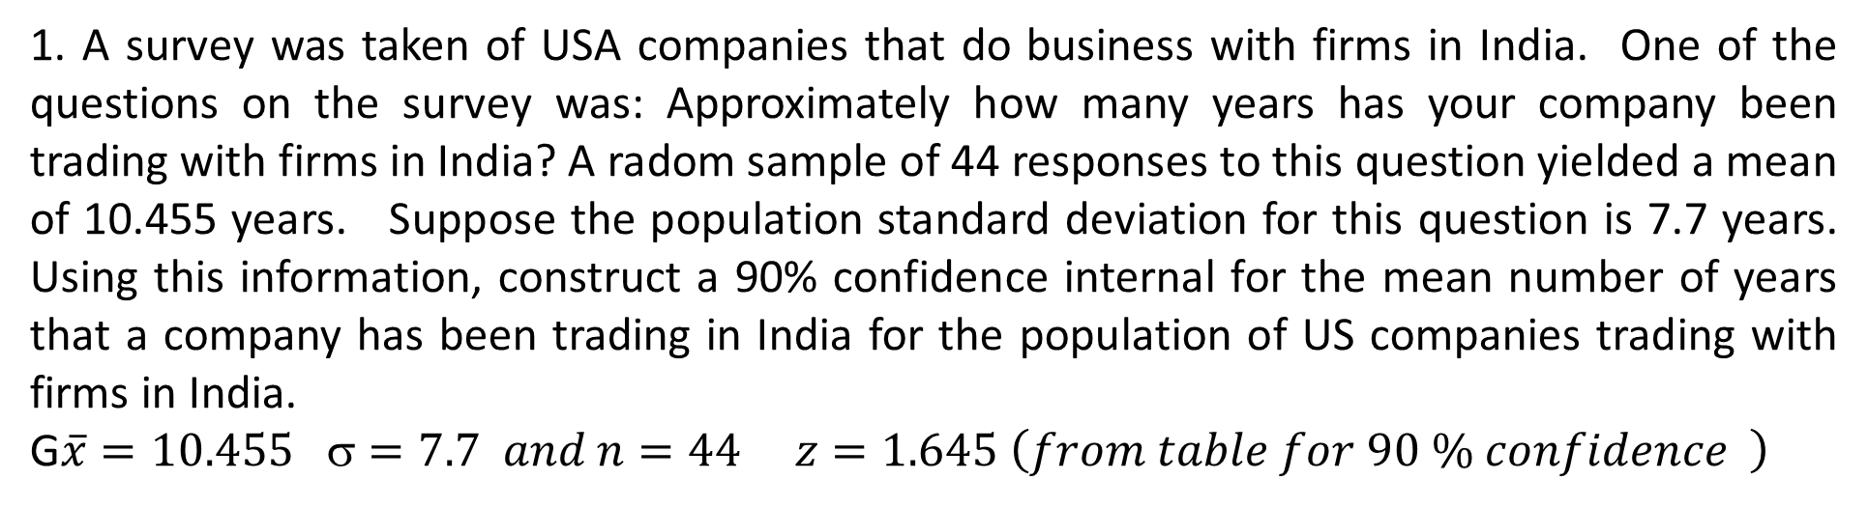
Problems
Mechanical Engineering Department
1. A survey was taken of USA companies that do business with firms in India. One of the questions on the survey was: Approximately how many years has your company been trading with firms in India? A radom sample of 44 responses to this question yielded a mean of 10.455 years. Suppose the population standard deviation for this question is 7.7 years. Using this information, construct a 90% confidence internal for the mean number of years that a company has been trading in India for the population of US companies trading with firms in India.
G$\overline{x}=10.455 σ=7.7 and n=44 z=1.645 \left(from table for 90 \% confidence \right)$
$$\overline{x }−Z \frac{σ}{\sqrt{n}} ≤ μ ≤ \overline{x }+Z \frac{σ}{\sqrt{n}}$$
$$10.455−1.645 \frac{7.7}{\sqrt{44}} ≤ μ ≤10.45+1.645 \frac{7.7}{\sqrt{44}}$$
$$8.545  12.365$$
The 90% confidence interval for the mean number of years that a company has been trading with firms in India is approximately [8.545,12.365] years

Slide 37
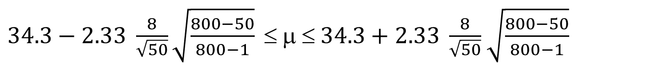
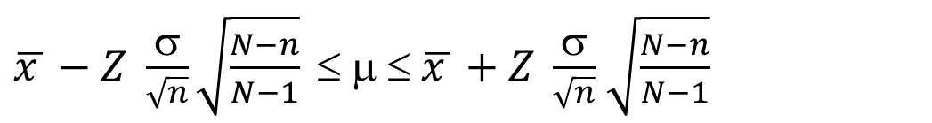

Problems
Mechanical Engineering Department
2. A study is conducted in a company that employs 800 engineers. A random sample of 50 engineers reveals that the average sample age is 34.3 years. Historically, the population standard deviation of the age of the company’s engineers is approximately 8 years. Construct a 98% confidence interval to estimate the average age of all the engineers in this company.
Given data: N = 800 n = 50 $\overline{x }$ = 34.3 $$ = 8 z = 2.33 from the table for 98% confidence)
$\overline{x }−Z \frac{σ}{\sqrt{n}}\sqrt{\frac{N−n}{N−1}} ≤ μ ≤ \overline{x }+Z \frac{σ}{\sqrt{n}}$ $\sqrt{\frac{N−n}{N−1}}$
$34.3−2.33 \frac{8}{\sqrt{50}}\sqrt{\frac{800−50}{800−1}} ≤ μ ≤ 34.3+2.33 \frac{8}{\sqrt{50}}$ $\sqrt{\frac{800−50}{800−1}}$
$$31,75    36.85$$
The 98% confidence interval to estimate the average age of all engineers in the company is approximately [31.67,36.93] years

Slide 38

Estimating the Mean of a Normal Population: Sample Size is Small and Population is unknown
Mechanical Engineering Department
When estimating the mean of a normal population with a small sample size and an unknown population standard deviation, you use the t-distribution instead of the normal distribution.
sample size (n) < 30
Steps to Construct the Confidence Interval
Determine the Sample Mean ($\overline{x}$) =
Determine the Sample Standard Deviation (σ)
Find the t-Score based on degree of freedom and confidence level or $t=\frac{\overline{x}−μ}{\frac{s}{\sqrt{n}}}$
Construct the Confidence Interval (CI)
$$\overline{x }−t_{α/2,n−1} \frac{σ}{\sqrt{n}} ≤ μ ≤ \overline{x }+t_{α/2,n−1}\frac{σ}{\sqrt{n}}$$

Slide 39

T-Distribution Characteristics
Mechanical Engineering Department
T distribution-symmetric, unimodal, mean =0, flatter in middle and have more area is their tails than the normal distribution
T distribution approach the normal curve as n becomes larger
T distribution is to be used when the population variance or population Std Dev is unknown, regardless of the size of the sample

Slide 40

Table of Critical Values of t
Mechanical Engineering Department

Slide 41
Problem
Mechanical Engineering Department
3. The owner of a large equipment rental company wants to make rather quick estimate of the average number of days a piece of ditch digging equipment is rented out per person per time. The company has records of all rentals, but the amount of time required to conduct an audit of all accounts would be prohibitive. The owner decides to take a random sample of rental invoices. Fourteen different rentals of ditch diggers are selected randomble from the files, yielding the following data. She uses these data construct a 99% confidence interval to estimate the average number of days that a ditch digger is rented and assumes that the number of datas per rental is normally distributed in the population. The data: 3, 1, 3, 2, 5, 1, 2, 1, 4, 2, 1, 3, 1,1
Given information:
n = 14
Sample data: 3, 1, 3, 2, 5, 1, 2, 1, 4, 2, 1, 3, 1,1
Confidence level = 99%

Slide 42



Problem
Mechanical Engineering Department
Calculate the Sample Mean
= 1.79
Calculate the Sample Standard Deviation (s)
$^{2}=\frac{\sum{{\left(x_{i}−\overline{x}\right)}^{2}}}{n−1}$ = $\frac{{\left(3−1.79\right)}^{2}+{\left(1−1.79\right)}^{2}+{\left(3−1.79\right)}^{2}+{\left(2−1.79\right)}^{2}+{\left(5−1.79\right)}^{2}+…+{\left(1−1.79\right)}^{2}}{14−1}$ =0.52
σ = 0.72
Df= n-1 = 13
$/{2 }=\frac{1−0.99}{2}=$ 0.005
t = 3.012 (from the table based on α and df)

Slide 43
Problem
Mechanical Engineering Department
$$\overline{x }−t_{α/2,n−1} \frac{σ}{\sqrt{n}} ≤ μ ≤ \overline{x }+t_{α/2,n−1}\frac{σ}{\sqrt{n}}$$
1.79$−3.012 \frac{0.72}{\sqrt{14}} ≤ μ ≤\text{1.79}+ 3.012 \frac{0.72}{\sqrt{14}}$
1.22 $  $ 2.36
The 99% confidence interval for the average number of days that a ditch digger is rented is approximately [1.22,2.36] days. This interval provides a range within which the true population mean is expected to lie with 99% confidence, assuming normal distribution of rental days.

Slide 44


Confidence Interval to Estimate the Population Proportion
Mechanical Engineering Department
To construct a confidence interval to estimate the population proportion, you use the sample proportion and the normal approximation if the sample size is large enough. n > 30
Calculate the Sample Proportion ($\hat{P}= \frac{x}{n}$​) where x is the number of successes and n is the sample size
Determine the z-Score for the Desired Confidence Level based on confidential level
Construct the Confidence Interval (CI)
$$\hat{P}−z_{α/2}\sqrt{\frac{\hat{p}\left(1−\hat{p}\right)}{n}} ≤ μ ≤\hat{P}+z_{α/2}\sqrt{\frac{\hat{p}(\hat{1−p})}{n}}$$

Slide 45



Problem
Mechanical Engineering Department
Assume you have a sample of 200 people where 80 of them favor a new policy. Construct a 95% confidence interval for the proportion of people who favor the policy.
1. Calculate the Sample Proportion ($\hat{P}= \frac{x}{n}$​) = $\frac{80}{200}$ =0.40
2. Determine the z-Score for a 95% Confidence Level z = 1.960
3. Calculate the Interval
$\hat{P}−z_{α/2}\sqrt{\frac{\hat{p}\left(1−\hat{p}\right)}{n}} ≤ μ ≤\hat{P}+z_{α/2}\sqrt{\frac{\hat{p}(1−\hat{p})}{n}}$
$0.40−1.96\sqrt{\frac{0.40\left(1−0.40\right)}{200}} ≤ μ ≤0.40+1.96\sqrt{\frac{\hat{.40}(1−0.40)}{200}}$
0.332 $  $ 0.468
The 95% confidence interval for the proportion of people who favor the new policy is approximately [0.332,0.468] This interval provides a range within which the true population proportion is expected to lie with 95% confidence.

Slide 46



Problem
Mechanical Engineering Department
A clothing company produces men’s Jeans. The jeans are made and sold with either a regular cut or a boot cut. In an effort to estimate the proportion of their men’s jeans market in Oklahoma city that prefers boot-cut jeans, the analyst takes a random sample of 423 jeans sales from the company two Oklahoma city retail outlets. Only 72 of the sales were for boot-cut jeans. Construct a 90% confidence interval to estimate the proportion of the population in Oklahoma city who prefer boot-cut jeans.
Given n = 423 x = 72 $\hat{p}=\frac{x}{n}=\frac{72}{423}=0.17$ z = 1.645 for 90% confidence from the table
$\hat{P}−z_{α/2}\sqrt{\frac{\hat{p}\left(1−\hat{p}\right)}{n}} ≤ μ ≤\hat{P}+z_{α/2}\sqrt{\frac{\hat{p}(1−\hat{p})}{n}}$
$0.17 −1.642\sqrt{\frac{0.17\left(1−0.17\right)}{423}} ≤ μ ≤0.17 −1.642\sqrt{\frac{0.17\left(1−0.17\right)}{423}}$
0.14 $   0.20$
The 90% confidence interval to estimate the proportion of the population in Oklahoma City who prefer boot-cut jeans is approximately [0.14,0.2]. This interval provides a range within which the true proportion of the population is expected to lie with 90% confidence.

Slide 47
Hypothesis Testing
Mechanical Engineering Department
Hypothesis is considered as intelligent guess or prediction, that gives directional to the researcher to answer the research question.
Hypothesis are defined as formal statement of the tentative or expected prediction or explanation of the relationship between two or more variables in a specified population.
A hypothesis is formal tentative statement of the expected relationship between two or more variable under study.
A hypothesis helps to translate the research problem and objective into a clear explaining or prediction of the expected results or outcome of the study.

Slide 48
Hypothesis Testing
Mechanical Engineering Department
Hypothesis testing refers to
Making an assumption about a population parameters
Collecting sample data
Calculating a sample statistic
Using the sample statistic to evaluate the hypothesis.
Null Hypothesis (H₀): State the hypothesized value of the parameter before sampling. The assumption we wish to test or the assumption we are trying to reject.
Population mean μ= 20 There is no difference between coke and diet coke
Alternative Hypothesis (H_{A}): All possible alternatives other than the null hypothesis
e.g μ > 20 and μ < 20
There is a difference between coke and diet coke.

Slide 49
Mechanical Engineering Department
Selecting and Interpreting Significance Level
Selecting and interpreting the significance level (α) is crucial in hypothesis testing.
The significance level, denoted as α, is the probability of rejecting the null hypothesis when it is actually true. It represents the threshold for determining whether the observed results are statistically significant.
Common Choices for α
0.10: Indicates a 10% risk of a Type I error
0.05: Indicates a 5% risk of a Type I error (most commonly used).
0.01: Indicates a 1% risk of a Type I error.
Interpreting the Significance Level (Comparison with α)
If p≤α, reject the null hypothesis
If p>α, do not reject the null hypothesis
Implications of α Choices
Higher α: More likely to reject the null hypothesis, increasing the risk of Type I errors.
Lower α: Less likely to reject the null hypothesis, reducing the risk of Type I errors but increasing the risk of Type II errors.

Slide 50
Parametric Tests
Mechanical Engineering Department
Parametric Test
2. Non Parametric tests
Parametric test Parametric tests that make specific assumptions about the parameters (the mean and variance) of the population distribution from which the data is drawn.
Applications
Used for continuous variables (y = f(x))
Used when data are measured on appropriate interval of ratio scale of measurement
Data should follow normal distribution

Slide 51

Parametric Tests
Mechanical Engineering Department
Parametric tests that make specific assumptions about the parameters (the mean and variance) of the population distribution from which the data is drawn.
Normality: Many parametric tests assume that the data follows a normal distribution (bell-shaped curve)
Homogeneity of Variance: Some parametric tests assume that different groups have similar variances (σ²)

Slide 52
Parametric Tests
Mechanical Engineering Department
t-Test: Used to compare the means of two groups to determine if they are statistically significantly different from each other.
Independent t-test (comparing two separate groups)
Paired t-test (for comparing two related groups)
One-Sample t-Test (To compare the mean of a single group to a known value or population mean)
ANOVA (Analysis of Variance): Used to compare the means of three or more groups to see if there is a significant difference among them.
One-way ANOVA (for one factor)
Two-way ANOVA (for two factors)
Pearson Correlation Coefficient: Measures the strength and direction of the linear relationship between two continuous variables.

Slide 53
Parametric Tests
Mechanical Engineering Department
Regression Analysis: Used to understand the relationship between a dependent variable and one or more independent variables.
Linear regression
Multiple and logistic regressions
Z-Test: Used to compare the sample mean to the population mean when the sample size is large and the population variance is known.

Slide 54
Parametric Tests-t test
Mechanical Engineering Department
Developed by Prof. W S Gosseti
A t-test compares the difference between two mean of different groups to determine whether the difference is statically significant.
One Sample t-test
Assumptions:
Population is normally distributed
Sample is drawn from the population, and it should be random
Known the population mean
Condition
Population standard deviation is not known
Size of the sample is small (<30)

Slide 55

Parametric Tests-t test-one sample
Mechanical Engineering Department
Steps to Perform a One-Sample t-Test:
1. State the Hypotheses
Null Hypothesis (H₀): μ=μ0​ (the sample mean is equal to the hypothesized population mean)
Alternative Hypothesis (H₁): μ≠μ0​ (the sample mean is not equal to the hypothesized population mean)
2. Calculate the t-Statistic: $t=\frac{\breve{x}−\text{μ}}{\frac{s}{\sqrt{n}}}$
3. Determine the Degrees of Freedom (df = n-1)
4. Find the p-Value: Compare the t-statistic to the t-distribution with the appropriate degrees of freedom to find the p-value
5. Make a Decision
Reject H₀ if the p-value is less than the significance level (α), commonly set at 0.05.
Fail to Reject H₀ if the p-value is greater than α.
6. Interpret the Results
If you reject the null hypothesis, it means there is a significant difference between the sample mean and the hypothesized population mean. If you fail to reject it, there is not enough evidence to suggest a significant difference.

Slide 56

Parametric Tests-t test
Mechanical Engineering Department
The following Data represents haemoglobin values in gm/dl for 10 patient 10.5 , 9, 6.5, 8, 11, 7, 7.5, 8.5, 9.5, 12 Is the mean value for patents significantly differ from the mean values of general population (12 gm/dl). Evaluate the role of change
Mean
$$\overline{x}=\frac{10.5+9+6.5+8+11+7+7.5+8.5+9.5+12}{10}$$
Standard
σ =$\frac{\sqrt{{\left(10.5−8.95\right)}^{2}+{\left(9−8.95\right)}^{2}+{\left(6.5−8.95\right)}^{2}+{\left(8−8.95\right)}^{2}+{\left(11−8.95\right)}^{2}+{\left(7−8.95\right)}^{2}+{\left(7.5−8.95\right)}^{2}+{\left(8.5−8.95\right)}^{2}+{\left(9.5−8.95\right)}^{2}+{\left(12−8.95\right)}^{2}}}{10−1}$
= 1.802
Step 1: State the Hypotheses
Null Hypothesis (H0​): The mean hemoglobin value of the patient sample is equal to the mean hemoglobin value of the general population.
H0:μ=12 gm/dl
Alternative Hypothesis (H1​): The mean hemoglobin value of the patient sample is different from the mean hemoglobin value of the general population.
H1:μ≠12 gm/dl

Slide 57


Parametric Tests-t test
Mechanical Engineering Department
Step 2: Calculate the t-Statistic
Step 3 Determine the Degrees of Freedom (df = n-1)
df = 10-1 = 9
Step 4: Then compare with tabulated value for 9 df and 5% level of significance it is = -1.8331. The calculated values > tabulated value
5. Make a Decision
Reject H0 and concluded that there is a statistically significant difference between the mean of sample ad population mean and this difference is unlikely due to change
6. Interpret the Results
The significant difference in mean hemoglobin values suggests that the patient group has a lower average hemoglobin level compared to the general population.
$t=\frac{\overset{̿}{x }−μ}{\frac{S}{\sqrt{n}} }$ = $\frac{8.95−12}{{1.80201}/{\sqrt{10}}}=−5.352$

Slide 58
Paired t-test
Mechanical Engineering Department
Used when measurements are taken from the same subject before and after some manipulation or treatment.
e.g. To determine the significance of a difference in blood pressure before and after administration of an experimental pressure substance.
Assumptions:
Populations are distributed normally
Samples are drawn independently and at Radom
Condition
Samples are related with each other
Sizes of the sample are small and equal

Slide 59

Paired t-test
Mechanical Engineering Department
State the Hypotheses
Null Hypothesis (H0​): The mean difference between the paired measurements is zero. H0:μd​=0
Alternative Hypothesis (H1): The mean difference between the paired measurements is not zero. H1:μd≠=0
2. Calculate the Differences
d_{i}​=After_{i​−}Before_{i}​
3. Calculate the Mean and Standard Deviation of the Differences
Mean of the differences $\overline{d}=\frac{\sum{d_{i}}}{n}$
Standard deviation of the differences (σ_{d​}) = $\frac{\sqrt{{\left(d_{i}−\overline{d}\right)}^{2}}}{n−1}$
4. Calculate the t-Statistic t = $\frac{\overline{d}}{{σ_{c}}/{\sqrt{n}}}$

Slide 60
Paired t-test
Mechanical Engineering Department
5. Compare t calculated and theoretical values
6. Conclusion
Blood pressure of 8 patients before and after treatment
BP before | BP after
180 | 140
200 | 145
230 | 150
240 | 155
170 | 120
190 | 130
200 | 140
165 | 130

Slide 61
Parametric Tests-t test
(One Sample two occasion)
Mechanical Engineering Department
State the Hypotheses
Null Hypothesis (H0): The mean difference in blood pressure before and after treatment is zero, implying no effect of the treatment. H0:μd=0
Alternative Hypothesis (H1​): The mean difference in blood pressure before and after treatment is not zero, implying an effect of the treatment. H1:μd≠0
2. Calculate the Differences
BP before | BP after | Dif (x)
180 | 140 | 40
200 | 145 | 55
230 | 150 | 80
240 | 155 | 85
170 | 120 | 50
190 | 130 | 60
200 | 140 | 60
165 | 130 | 35
 |  | ∑x= 465

Slide 62



Parametric Tests-t test
(One Sample two occasion)
Mechanical Engineering Department
3. Calculate the Mean and Standard Deviation of the Differences
Mean of difference
Standard deviation of the differences

Slide 63


Parametric Tests-t test
(One Sample two occasion)
Mechanical Engineering Department
4. Calculate the t-Statistic
5. Compare t calculated and theoretical values
Tabulated (Dof = 7), with level of significance 0.05, two tails = 2.36
6. Conclusion
‘t’ calculated value is higher than table values hence reject the null hypothesis.
This indicates that there is a significant difference in blood pressure before and after treatment, suggesting that the treatment had a substantial effect.

Slide 64
Hypothesis Testing for ρ
(Repeated Measures t-test)
Mechanical Engineering Department
Two researcher is conducting a study to evaluate the frequency of sheep collisions during a driving test. Over the course of a day driving test, the number of sheep hit by vehicles is recorded. The data collected from multiple driving tests is as follows:
Subject | Score on test A | Score on test B
1 | 28 | 25
2 | 26 | 27
3 | 33 | 28
4 | 30 | 31
5 | 32 | 29
6 | 30 | 30
7 | 31 | 32
8 | 18 | 21
9 | 22 | 25
10 | 24 | 20

Slide 65
Parametric Tests-t test
(One Sample two occasion)
Mechanical Engineering Department
State the Hypotheses
Null Hypothesis (H0​): There is no significant difference in the mean number of sheep collisions between Test A and Test B. H0​:μ_{A}​=μ_{B}​
Alternative Hypothesis (H1​): There is a significant difference in the mean number of sheep collisions between Test A and Test B. H1:μA≠μB
2. Calculate the Differences
Subject | Score on test A | Score on test B | Difference D
1 | 28 | 25 | 3
2 | 26 | 27 | -1
3 | 33 | 28 | 5
4 | 30 | 31 | -1
5 | 32 | 29 | 3
6 | 30 | 30 | 0
7 | 31 | 32 | -1
8 | 18 | 21 | -3
9 | 22 | 25 | -3
10 | 24 | 20 | 4
 |  |  | ∑D= 6

Slide 66


Parametric Tests-t test
(One Sample two occasion)
Mechanical Engineering Department
3. Calculate the Mean and Standard Deviation of the Differences
Mean of difference
Standard deviation of the differences

Slide 67

Parametric Tests-t test
(One Sample two occasion)
Mechanical Engineering Department
4. Calculate the t-Statistic
5. Compare t calculated and theoretical values
Tabulated (Dof = 9), with level of significance 0.05, two tails = 2.262
6. Conclusion
‘t’ calculated value is Lower than table values hence accept the null hypothesis.
In this paired t-test, you would conclude that there is no significant difference in the number of sheep collisions between Test A and Test B

Slide 68
Two sample t-test
Mechanical Engineering Department
Used when the two independent random samples come from the normal populations having unknown or same variance
We test the null hypothesis that the two population means are same i.e μ₁ = μ₂
Assumptions
Population are distributed normally
Samples are drawn independently and at random
Conditions
Standard deviation in the populations are same and not known
Size of the sample is small

Slide 69

Two sample t-test-Procedure
Mechanical Engineering Department
State the Hypotheses
Null Hypothesis (H0​): There is no significant difference between the means of the two populations. H0:μ1=μ2​
Alternative Hypothesis (H1​): There is a significant difference between the means of the two populations. H1:μ1≠μ2
2. Collect and Summarize Data
Sample Means: ${\overline{x}}_{1}$for group 1 and ${\overline{x}}_{2}$for group 2
Sample variance $s_{1}^{2}$ for group 1 and $s_{2}^{2}$ for group 2
Sample size n₁ for group 1 and n₂ group 2

Slide 70


Two sample t-test-Procedure
Mechanical Engineering Department
3. Calculate the Test Statistic
Equal Variances Assumed (Calculate the pooled variance
Calculate the test statistic:
4. Calculate Degrees of Freedom Equal Variances Assumed df=n1+n2−2
5. Find t value in table
6. Conclusions

Slide 71

Two sample t-test
Mechanical Engineering Department
The following data represent weight in kg for 10 males and 12 females
Males 80, 75, 95, 55, 60, 70, 75, 72, 80, 65
Females 60, 70, 50, 85, 45, 60, 80. 65, 70, 62, 77, 82 Show that hypothesis
Step 1: Hypotheses:
Null Hypothesis (H0​): There is no significant difference between the mean weight of males and females. H0:μ_{males}=μ_{females}
Alternative Hypothesis (H1​): There is a significant difference between the mean weight of males and females.​H1​:μ_{males​}≠μ_{females​}
Step 3: Calculate Sample Statistics:
Males: Deviations

Slide 72

Two sample t-test
Mechanical Engineering Department
Sample Size (n1​)=10
For Females
S₂² = 192.23
Sample size = 12

Slide 73


Two sample t-test
4. Calculate t values
= = 210.56
= 0.29
4. Calculate 5.Degrees of Freedom df = n₁ +n₂-2 =20
5. Find the p-value
Use a t-distribution table or calculator to find the p-value for t=0.29 df=20.
For a two-tailed test, you compare the p-value to your significance level (α typically 0.05)
6. Make a Decision
If the p-value is large (e.g., greater than 0.05), fail to reject the null hypothesis. There is no significant difference in average weights between males and females.
Perform the above calculations to finalize the results. The t-test result indicates whether there is a significant difference in average weights between the two groups.
Mechanical Engineering Department

Slide 74


Z-test
Mechanical Engineering Department
A Z-test is a statistical test used to determine whether there is a significant difference between sample and population means or between the means of two independent samples. It is based on the Z-distribution, which is a special case of the normal distribution with a mean of 0 and a standard deviation of 1. The Z-test is appropriate when the sample size is large (typically n>30) or when the population variance is known
Assumption
Population is normally distributed
The sample is drwon at random
Condition
Population standard deviation σ is known
Size of the sample is large (n>30)
One-Sample Z-Test
Two-Sample Z-Test

Slide 75
Z-test-steps
Mechanical Engineering Department
State the Hypotheses
Null Hypothesis (H0​): There is no effect or difference.
Alternative Hypothesis (H1​): There is a significant effect or difference.
2. Calculate the Z-Statistic:
3. Determine the p-value:
4. Make a Decision
5. Report the Results

Slide 76

Hypothesis Testing Z- test
Mechanical Engineering Department
One of Real Estate advertises that the mean selling time of a residential home is 40 days or less after it is listed in their company. A sample of 50 recently sold homes shows a sample mean selling time of 45 days and a standard deviation of 20 days. Using a 0.02 level of significance, test the validity of the company’s claim.
Given: n = 50, mean = 45 days, standard devotion = 20 days, significant level = 0.02
Step 1: Hypotheses
Null Hypothesis (H0​): The mean selling time is 40 days or less. H0​:μ ≤ 40
Alternative Hypothesis (H1​): The mean selling time is greater than 40 days. H1​:μ>40
This is a one –tailed test with α=0.02 then critical value is Z_{0.02} = 2.05
Step 2: Calculate the Test Statistic
$Z= \frac{\overset{̿}{x} − μ_{0} }{S_{\overline{x}}}= \frac{45−40}{\frac{20}{\sqrt{50}}}$ = 1.77

Slide 77
Hypothesis Testing Z- test
Mechanical Engineering Department
d) Since z= 1.77 is less than 2.05, we do not reject the null hypothesis. A sample selling time 45 days is not significantly greater than population mean of 40 days at 0.02 level of confidence.
The sample does not provide sufficient evidence to suggest that the mean selling time is greater than 40 days.

Slide 78


Hypothesis Testing Z- test
2. The height of adults in a certain town is found to have a mean of 166.17 cm with standard deviation of 5.89 cm. A random sample of 144 adults in the slum section of the town is discovered to have a mean height of 164.65 cm. Does this height indicate theat the residents of the slum area are significantly shorter in height at 0.05 level of significance?.
Set the null and alternative hypothesis
H₀: μ ≥ 166.17 H_{a} : μ < 166.17 cm
b) Population standard deviation σ is 5.89 and sample size is large at n = 144 use the Z-static. This is also a one tailed test with α=0.05. the critical point is Z_{0.05}=1.65 We shall reject H₀ if Z<-1.65
c) Computation
$Z= \frac{\overset{̿}{x} − μ_{0} }{S_{\overline{x}}}= \frac{164.65−166.7}{\frac{5.89}{\sqrt{114}}}$ = -3.93
d) Since z= -3.93 is less than -1.65, we reject the null hypothesis. This means the height of adults in the slum section of the town significantly lower than 166.7 cm at 0.05 level of signicance.

Slide 79


Pearson’s ‘r’ Correlation
Pearson's correlation coefficient, often denoted by r, measures the strength and direction of the linear relationship between two continuous variables
Formula
The formula for Pearson’s correlation coefficient r is:
2. Interpretation

Slide 80

Pearson’s ‘r’ Correlation
3. Significance Testing
To determine if the correlation is statistically significant, you can use a t-test:
The t-value can then be compared to the critical value from the t-distribution table with n−2n - 2n−2 degrees of freedom to determine significance.

Slide 81
Pearson’s ‘r’ Correlation-Problem
We have collected data on the length of hands (in centimeters) and height (in centimeters) for 5 individuals. The data is as follows:
Calculate and Interpret the Correlation coefficient of the two variable
Person | Hand | Height
A | 17 | 150
B | 15 | 154
C | 19 | 169
D | 17 | 172
E | 21 | 175
 | x | y | xy | x² | y²
A | 17 | 150 | 2550 | 289 | 22500
B | 15 | 154 | 2310 | 225 | 23716
C | 19 | 169 | 3211 | 361 | 28561
D | 17 | 172 | 2924 | 289 | 29584
E | 21 | 175 | 3675 | 441 | 30625
Total | 89 | 820 | 14670 | 1605 | 134986
r = 0.72
The formula gives us a correlation coefficient of 0.72, (Critical value is 832) which is a high, positive correlation. Meaning that in this data set, as height increases, so does hand height.

Slide 82
Pearson’s ‘r’ Correlation-Problem
Calculate and Interpret the Correlation coefficient of the two variable
Person | Weight | Blood Pressure
A | 150 | 125
B | 169 | 130
C | 175 | 160
D | 180 | 169
E | 200 | 150
 | x | y | xy | x² | y²
A | 150 | 125 | 18750 | 22500 | 15625
B | 169 | 130 | 21970 | 28561 | 16900
C | 175 | 160 | 28000 | 30625 | 25600
D | 180 | 169 | 30420 | 32400 | 28561
E | 200 | 150 | 30000 | 40000 | 22500
Total | 874 | 734 | 129140 | 154086 | 109186
r = 0.61
Weight and blood pressure have a moderate, positive correlation.

Slide 83
Pearson’s ‘r’ Correlation-Problem
1. Suppose you computed r = 0.801 using n = 10 data. Explain significant of the data
From the Table for n =10 the critical values ± 0.685 then
r is not significant between + 0.685 and – 0.685 but it is significant > 0.685
2. Suppose you computed r = -0.624 using n = 14 data. Explain significant of the data
From the Table for n =14 the critical values ± 0.592 then
r is not significant between + 0.592 and – 0.592 but -0.624 it is significant s
3. Suppose you computed r = 0.776 using n = 6 data. Explain significant of the data
From the Table for n =6 the critical values ± 0.832 then
r is not significant between + 0.832 and – 0.832 but it is significant > 0.811

Slide 84
ANOVA (analysis of Variance)
ANOVA is a collection of statistical models used to analyse the difference between group means or variance
Compares Multiple groups at on time
Developed by R A Fischer
There are two ANOVA
One Way ANOVA
Two Way ANOVA

Slide 85
One Way ANOVA
Compares two or more unmatched groups when data are categorised in on Factor
E.g Comparing a control group with three different does aspirin
Comparing the proceptivity of three or more employees based on working hours in a company

Slide 86
ANOVA-Problems- One Way
1. Set up an analysis of variance table for the following per acre production data for three Varieties of wheat, each grown on four plots. Consider variety differences to be significant
 | Per Area Production data variety of Wheat
Plot of Land | A | B | C
1 | 6 | 5 | 5
2 | 7 | 5 | 4
3 | 3 | 3 | 3
4 | 8 | 7 | 4

Slide 87
ANOVA-Problems- One Way
Solutions
Step 1: Null Hypothesis (H0): let us take the hypothesis that there is no significant difference in production of three varieties
Step 2: Correction Factor (CF)
CF = (∑X)²/N = 60²/12 = 300
Step 3: Sum of Squares Total = ∑X² –CF = 332-300
SST = 30
Step 4: Sum of squares between SSB
SSB= (∑A)²/4 + (∑B)²/4 + (∑C)² /4 –CF = 8
Step 5: SSW = SST-SSB = 30 – 8 = 24
A | B | C |  | A² | B² | C²
6 | 5 | 5 |  | 36 | 25 | 25
7 | 5 | 4 |  | 49 | 25 | 16
3 | 3 | 3 |  | 9 | 9 | 9
8 | 7 | 4 |  | 64 | 49 | 16
∑A =24 | ∑B =20 | ∑C =16 |  | ∑A² =24 | ∑B²=20 | ∑C² =16
∑X =∑A+∑B+∑C =60 |  |  |  | ∑X² =∑A² +∑B²+∑C² =332
Step 5
DoF for sum of squares = N-1 = 12-1 = 11
DoF for sum of squares between SSC = K-1 = 3-1 =2
DoF for squares with the groups = N-K = 9

Slide 88
ANOVA-Problems- One Way
Solutions
Sum of variance | Sum of Squares | DoF | Mean of Squares | F Ratio | F critical for 5% level
Between Sample | SSB = 8 | K-1 = 2 | 8/2 = 4 | 4 / 2.67 =1.5 | F(2,9) =19.45 H0 accepted
With in sample | SSW = 24 | N-K = 9 | 24/9 = 2.67
Total | 32 | N-1 =11

Slide 89
ANOVA-Problems- One Way
2. Is there a statistically significant difference in the mean weight loss among the four diets? We will run the ANOVA using the five-step approach
Per Area Production data variety of Wheat
Low Calorie(A) | Low Fat(B) | Low carbohydrate(C) | Control (D)
8 | 2 | 3 | 2
9 | 4 | 5 | 2
6 | 3 | 4 | -1
7 | 5 | 2 | 0
3 | 1 | 3 | 3

Slide 90
ANOVA-Problems- One Way
Solutions
Step 1: Set up hypotheses and determine level of significance. H₀: μ₁ = μ₂ = μ₃ = μ₄ H₁: Means are not all equal α=0.05
Step 2: Correction Factor (CF)
CF = (∑X)²/N = 71²/20 = 252.5
Step 3: Sum of Squares Total = ∑X² –CF = 375-252.5 SST = 119.95
Step 4: Sum of squares between SSB
SSB= (∑A)²/5 + (∑B)²/5 + (∑C)² /5 + (∑D)² /5 –CV = 75.75
Step 5: Sum of squares with the groups
SSW = SST-SSB = 119.95 – 75.75 = 47.2
A | B | C | D |  | A² | B² | C² | D²
8 | 2 | 3 | 2 |  | 64 | 4 | 9 | 4
9 | 4 | 5 | 2 |  | 81 | 16 | 25 | 4
6 | 3 | 4 | -1 |  | 36 | 9 | 16 | 1
7 | 5 | 2 | 0 |  | 49 | 25 | 4 | 0
3 | 1 | 3 | 3 |  | 9 | 1 | 9 | 9
∑A =33 | ∑B =15 | ∑C =17 | ∑C =6 |  | ∑A² =239 | ∑B²=55 | ∑C² =63 | ∑D² =18
∑A+∑B+∑C+ ∑D=71 |  |  |  |  | ∑X² =∑A² +∑B²+∑C² +∑D² =375
Step 5
DoF for sum of squares = N-1 = 20-1 = 19
DoF for sum of squares between SSB = K-1 = 4-1 =3
DoF for squares with the groups = N-K = 20-4 = 16

Slide 91
ANOVA-Problems- One Way
Solutions
Sum of variance | Sum of Squares | DoF | Mean of Squares | F Ratio | F critical for 5% level
Between Sample | SSB = 75.75 | K-1 = 3 | 75.75/3 = 25.25 | 25.25 / 2.95 =8.56 | F(3,16) =3.25 H0 Rejected
With in sample | SSW = 47.2 | N-K = 16 | 47.2/16 = 2.95
Total | 122.95 | N-1 =19
We reject H₀ because 8.43 > 3.24. We have statistically significant evidence at α=0.05 to show that there is a difference in mean weight loss among the four diets.

Slide 92
ANOVA-Problems- One Way
3. Is there a statistically significant difference in mean calcium intake in patients with normal bone density as compared to patients with osteopenia and osteoporosis? We will run the ANOVA using the five-step approach.
Normal Bone Density (A) | Osteopenia (B) | Osteoporosis (C)
1200 | 1000 | 890
1000 | 1100 | 650
980 | 700 | 1100
900 | 700 | 1100
780 | 500 | 400
800 | 700 | 350

Slide 93
ANOVA-Problems- One Way
Solutions
Step 1: Set up hypotheses and determine level of significance H₀: μ₁ = μ₂ = μ₃ H₁: Means are not all equal α=0.05
Step 2: Correction Factor (CF)
CF = (∑X)²/N = 12251250
Step 3: Sum of Squares Total SST = ∑X² –CF = 1054650
Step 4: Sum of squares between SSB
SSB= (∑A)²/4 + (∑B)²/4 + (∑C)² /4 –CV = 129700
Step 5: SSW = SST-SSB = 924950
A | B | C |  | A² | B² | C²
1200 | 1000 | 890 |  | 1440000 | 1000000 | 792100
1000 | 1100 | 650 |  | 1000000 | 1210000 | 422500
980 | 700 | 1100 |  | 960400 | 490000 | 1210000
900 | 700 | 1100 |  | 810000 | 490000 | 1210000
780 | 500 | 400 |  | 608400 | 250000 | 160000
800 | 700 | 350 |  | 640000 | 490000 | 122500
5660 | 4700 | 4490 |  | 5458800 | 3930000 | 3917100
∑X =∑A+∑B+∑C =14850 |  |  |  | ∑X² =∑A² +∑B²+∑C² =13305900
Step 5
DoF for sum of squares = N-1 = 18-1 = 17
DoF for sum of squares between SSC = K-1 = 6-1 =5
DoF for squares with the groups = N-K = 13

Slide 94
ANOVA-Problems- One Way
Solutions
Sum of variance | Sum of Squares | DoF | Mean of Squares | F Ratio | F critical for 5% level
Between Sample | SSB = 129700 | K-1 = 5 | 129700/5 = 25940 | 4 / 2.67 =1.5 | F(5,13) =3.68 H0 accepted
With in sample | SSW = 924950 | N-K = 13 | 924950/13 =71150 | 71150/25940 = 2.74
Total | 1054650 | N-1 =17
we do not reject H₀ because 1.395 < 3.68. We do not have statistically significant evidence at a =0.05 to show that there is a difference in mean calcium intake in patients with normal bone density as compared to osteopenia and osterporosis.

Slide 95
ANOVA-Problems- Two Way
Used to determine the effect of two nominal predictor variables on a continuous outcome variable
It analyses the effect of the independent variables on the expected outcome along with their relationship to the outcome itselt.
Ex. Comparing the employee productivity based on the working hours and working conditions.
Assumptions of ANOVA
The sample are independent and selected randomly
Parent population from which samples are taken is of normal distribution
Various treatment and environmental effects are additive in nature
The experimental errors are distributed normally with mean zero and variance σ²

Slide 96

ANOVA-Problems- Two Way
ANOVA compares variance by means of F ratio
F = $\frac{Variance between sampels }{Variance within sample }$
It again depends on experimental design
Null hypothesis
H₀ All population means are same
If the computed F_{c} is greater than F-critical values we are likely to reject the null hypothesis
If the computed F_{c} lesser than the F critical value, then the nuyll hypothesis is accepted.

Slide 97
ANOVA-Problems- Two Way
ANOVA compares variance by means of F ratio
F = $\frac{Variance between sampels }{Variance within sample }$
It again depends on experimental design
Null hypothesis
H₀ All population means are same
If the computed F_{c} is greater than F-critical values we are likely to reject the null hypothesis
If the computed F_{c} lesser than the F critical value, then the nuyll hypothesis is accepted.

Slide 98
ANOVA-Problems- Two Way
ANOVA compares variance by means of F ratio
F = $\frac{Variance between sampels }{Variance within sample }$
It again depends on experimental design
Null hypothesis
H₀ All population means are same
If the computed F_{c} is greater than F-critical values we are likely to reject the null hypothesis
If the computed F_{c} lesser than the F critical value, then the nuyll hypothesis is accepted.

Slide 99
Using the following data, perform a oneway analysis of variance using α=.05α=.05. Write up the results in APA format.
ANOVA-Problems- Two Way
1. A farmer applied three types of fertilizers on Four separate plots. Two Figure on yield per acre are tabulated bellow
 | Yield
Plots Fertilizers | A | B | C | D
Nitrogen | 6 | 4 | 8 | 6
Potash | 7 | 6 | 6 | 9
Phosphates | 8 | 5 | 10 | 9
Find out if the plots are materially different in fertility as also, if three fertilizers any material difference in yield

Slide 100
Using the following data, perform a oneway analysis of variance using α=.05α=.05. Write up the results in APA format.
ANOVA-Problems- Two Way
Step 1: Null hypothesis: Let us take the hypothesis that
i. All plots are not significantly differ in fertility (Column wise Analysis)
ii. All the fertilizers are not significantly differ in the yields ( Row wise analysis)
Step 2:
A | B | C | D | Total | A² | B² | C² | D²
6 | 4 | 8 | 6 | 24 | 36 | 16 | 64 | 36
7 | 6 | 6 | 9 | 28 | 49 | 36 | 36 | 81
8 | 5 | 10 | 9 | 32 | 64 | 25 | 100 | 81
21 | 15 | 24 | 24 | T=84 | 149 | 77 | 200 | 198
Step 3: Correlation Factor (CF) = (∑x)²/N = 88²/12 = 588
Step 4: Sum of Square Total (SST) = ∑x² – C =149+ 77+200+198 -588 =36
Step 5: Sum of square Between Columns = SSC= (∑A)²/n + (∑B)²/n + (∑C)²/n+ (∑D)²/n –C =
21²/3+15²/3+24²/3+24²/4 -588 =18

Slide 101
Using the following data, perform a oneway analysis of variance using α=.05α=.05. Write up the results in APA format.
ANOVA-Problems- Two Way
Step 6: Sum of square between Rows =SSR = 24²/4+28²/4+32²/4 –588 = 8
Step 7: Sum of square with the Group = SSW = SST –SSC –SSR = 36 -18 – 8 =10
Step 8:
DoF for total sum of square = N-1 =12-1 = 11
DoF for sum of squares between the column = C -1 = 4-1 = 3
Dof for sum of squares between the Rows = R-1 =3-1 = 2
DoF for sum of square with the Group = (C-1)(R-1) = 6
Step 9: Anova construction
Source of variance | Sum of Squares | Degree of Freedom | Mean of sum of squares | F Ratio | Table value
Between Column | SSC =18 | C-1 = 4-1 = 3 | 18/3 =6 | 6/1.667 =3.6 | F(3,6) = 8.94 H0 accepted
Between Rows | SSR =8 | R-1 = 3-1 =2 | 8/2 =4 | 4/1.667 = 2.4 | F(2,6) = 19.33 H) Accepted
With the Group | SSW =10 | (R-1)(c-1) = 6 | 10/6 =1.667
Total | SST = 36 | N-1 = 11

Slide 102
ANOVA-Problems- Two Way
Step 10: Interpretation
Columns wise analysis: The computed values of F =3.6 is less than the Table value 8.94, hence he null hypothesis is accepted, it means the plots are not significantly differ I fertility
Row wise Analysis: The calculated value of F =2.4 is less than the Table Value 19.33, hence the null hypothesis is accepted, it means the fertilizers are alike sof for as productivity concern

Slide 103
ANOVA-Problems- Two Way
2. A Manger applied three five type of operator and four type of machines. Two Figure on production are tabulated bellow
Operataor (j) | Machne (i)
 | 1 | 2 | 3 | 4
1 | 46 | 56 | 35 | 47
2 | 54 | 55 | 51 | 56
3 | 48 | 56 | 50 | 58
4 | 46 | 60 | 51 | 59
5 | 51 | 53 | 53 | 55
Find out if the operator are materially different in Machine as also, if four machines any material difference in yield

Slide 104
ANOVA-Problems- Two Way
Step 1: Null hypothesis: Let us take the hypothesis that
i. All operator are not significantly differ in productivity (Column wise Analysis)
ii. All the Machines are not significantly differ in the productivity (Row wise analysis)
Step 2:
0 | 1 | 2 | 3 | 4 | R-sum
1 | 46 | 56 | 35 | 47 | 184 |  | 2116 | 3136 | 1225 | 2209
2 | 54 | 55 | 51 | 56 | 216 |  | 2916 | 3025 | 2601 | 3136
3 | 48 | 56 | 50 | 58 | 212 |  | 2304 | 3136 | 2500 | 3364
4 | 46 | 60 | 51 | 59 | 216 |  | 2116 | 3600 | 2601 | 3481
5 | 51 | 53 | 53 | 55 | 212 |  | 2601 | 2809 | 2809 | 3025
C-Sum | 245 | 280 | 240 | 275 | T=1040 |  | 12053 | 15706 | 11736 | 15215 | ∑X² ⁼ 54710
Step 3: Correlation Factor (CF) = (∑x)²/N = 1040²/12 = 54080
Step 4: Sum of Square Total (SST) = ∑x² – C =57710-54080 =630
Step 5: Sum of square Between Columns = SSC= (∑1)²/n + (∑2)²/n + (∑3)²/n+ (∑4)²/n –C =
250

Slide 105
ANOVA-Problems- Two Way
Step 6: Sum of square between Rows =SSR = 54264–54080 = 184
Step 7: Sum of square with the Group = SSW = SST –SSC –SSR = 196
Step 8:
DoF for total sum of square = N-1 =20-1 = 19
DoF for sum of squares between the column = 4 -1 = 4-1 = 3
Dof for sum of squares between the Rows = R-1 =5-1 = 4
DoF for sum of square with the Group = (C-1)(R-1) = 12
Step 9: Anova construction
Source of variance | Sum of Squares | Degree of Freedom | Mean of sum of squares | F Ratio | Table value
Between Column | SSC =250 | C-1 = 4-1 = 3 | 250/3 =83.33 | 83.33/16.33 =5.1 | F(3,12) = 3.49 H0 rejected
Between Rows | SSR =184 | R-1 = 5-1 =4 | 184/4 =46 | 46/16.33 = 2.81 | F(4,12) = 3.26 H) Accepted
With the Group | SSW =196 | (R-1)(c-1) = 12 | 196/12 =16.33
Total | SST = 36 | N-1 = 19

Slide 106
ANOVA-Problems- Two Way
Step 10: Interpretation
From the F-tables F(4,12) = 3.26 and F(3,12) = 3.49.
Since 6.81 > 3.49 we conclude that we do have sufficient evidence at the 5% level of significance to reject the null hypothesis that there in difference between the machines.
Since 2.81 < 3.26 we conclude that we do not have sufficient evidence to reject the null hypothesis that there is no difference between the operators.

Slide 107
Non-Parametric Tests
While most common statistical analyses (e.g., t-tests, ANOVA) are parametric, they need to fulfil a number of criteria before we use them
These criteria include satisfying the assumptions of outliers, linearity, normality, homoscedasticity, to name a few
If the data do not fulfil the criteria to conduct the parametric tests, we can opt for non-parametric tests, which do not require those assumptions
Do note that non-parametric tests make less assumptions, not no assumptions!
The trade-off is that non-parametric tests are generally lower in power

Slide 108
Non-Parametric Tests
Techniques that do not rely on data belonging to any particular distribution
Nonparametric statistics do not assume any underlying distribution of parameter
Nonparametric does not meant that model lack parameters but that the number and nature of the parameters are flexible
There are some situations when it is clear that the outcome does not follow a normal distribution. These include:
When the outcome is an ordinal variable or a rank
When there are definite ouliers
When the outcome has clear limits of detection

Slide 109

Difference between Parametric and Non-Parametric Tests

Slide 110
Difference between Parametric and Non-Parametric Tests
Description | Parametric |  | Non-Parametric
Assumed Distribution | Normal |  | Any
Typical data | Ratio or interval |  | Nominal or ordinal
Usual Central Measures | Mean |  | Median
Benefits | Can draw Many conclusion |  | Simplicity less affected by Outliers
TESTS
One sample test |  |  | Chi-square test One Sample sign test
Independent Measures, 2 groups |  | Independent Measure t-test | Mann-Whitney test
Independent Measures, >2 groups |  | One way independent measure ANOVA | Kruskal Walles Test
Repeated Measures, 2 Condition |  | Matched pair t-test | Wilcoxon text

Slide 111
Chi-Square test
Chi-square test (x²) The Chi-Square test is used to assess whether observed frequencies in categorical data differ significantly from expected frequencies. It is commonly applied in two main types:
Chi-Square Test of Independence: Evaluates if two categorical variables are independent or associated.
Chi-Square Test of Goodness of Fit: Determines if a sample data matches the expected distribution.

Slide 112


Chi-Square test
Chi-Square Test of Independence: Procedure
1.Set Up the Hypotheses:
Null Hypothesis (H₀): The variables are independent (no association).
Alternative Hypothesis (H₁): The variables are dependent (there is an association).
2. Create a Contingency Table:Tabulate the observed frequencies for each combination of the variables.
3. Calculate the Expected Frequencies:
4. Compute the Chi-Square Statistic: (O_{ij} observe frequency)
5. Determine the Degrees of Freedom (df) = (number of rows-1) (number of column-1)
6. Compare to the Critical Value:
If χ2_{calculated} > χ2_{critical}, reject the null hypothesis.

Slide 113



Chi-Square test
Suppose we want to test if there is an association between gender and voting preference in an election. We collect the following data:
Step 1: Hypothesis
H0​:Gender and Preference are independent
H1​:Gender and Preference are dependent
Create a Contingency Table Chi-Square Calculation
=1.01
Degree of freedom = (2-1)(2-1) =1
Critical value α = 0.05 and df = 1 is 3.841
Decision: Since χ2=1.01<3.841 we fail to reject the null hypothesis,
suggesting no significant association between gender and voting preference.

Slide 114
Chi-Square test
Example 1 A die is thrown with following results. Is the die unbiased?
Number of turned up | 1 | 2 | 3 | 4 | 5 | 6
Frequency | 16 | 20 | 25 | 14 | 29 | 28
Solution: Let us take the hypothesis that the die is unbiased. If that is so, the probability of obtaining any one of the six number is 1/6 and as such the expected frequency of any one number coming upward is E_{f} = 132 *1/6 = 22. Now we can write the observed frequencies along with expected frequencies and work out the values of λ² as follows

Slide 115
Chi-Square test
No. of turned up | Observed Frequency, O_{f} | Expected Frequency, E_{f} | (O_{f} – E_{f}) | (O_{f} – E_{f})² | (O_{f} –E_{f})²/E_{f}
1 | 16 | 22 | -6 | 36 | 36/22
2 | 20 | 22 | -2 | 4 | 4/22
3 | 25 | 22 | 3 | 9 | 9/22
4 | 14 | 22 | -8 | 64 | 64/22
5 | 29 | 22 | 7 | 49 | 49/22
6 | 28 | 22 | 6 | 36 | 36/22
Σ | 132 |  |  |  | 9
Σ[(O_{f}-E_{f})²/E] =9
Hence the calculated value of λ² = 9 then Degree of freedom in the given problem is (n-1) = (6-1) =5
The Table value of λ² for 5 DoF at 5% level of significance is 11.071. Comparing computed values and table values of λ², we find that computed values is less than the table values and as such could have arisen due to fluctuations of sampling. The result, thus, support the hypothesis and it can be concluded that the die is unbiased.

Slide 116

Chi-Square test
2. One sample sign test: It is based on the direction or the plus or minus signs of observation in a sample and not on their numerical magnitudes
Problem: The compressive strength of insulating blocks used in the construction of new houses is tested by a civil engineer. The engineer needs to be certain at the 5% level of significance that the median compressive strength is at least 1000 psi. Twenty randomly selected blocks give the following results:
Test (at the 5% level of significance) the null hypothesis that the median compressive strength of the insulting blocks is 1000 psi against the alternative that it is greater

Slide 117



Chi-Square test
Solution The hypotheses are H0 : θ = 1000 and H1 : θ > 1000
We have 14 plus signs and the required probability value is calculated directly from the binomial formula as ( for binomial distribution p =1/2

Slide 118



Chi-Square test
Since we are performing a one-tailed test, we must compare the calculated value with the value 0.05. Since 0.05 < 0.05766 we conclude that we cannot reject the null hypothesis and that on the basis of the available evidence, we cannot conclude that the median compressive strength of the insulating blocks is greater than 1000 psi.

Slide 119

Chi-Square test
2. A certain type of solid rocket fuel is manufactured by bonding an igniter with a propellant. In order that the fuel burns smoothly and does not suffer either “flame-out” or become unstable it is essential that the material bonding the two components of the fuel has a shear strength of 2000 psi. The results arising from tests performed on 20 randomly selected samples of fuel are as follows:
Using the 5% level of significance, test the null hypothesis that the median shear strength is 2000 psi.

Slide 120





Chi-Square test
The hypotheses are H0 : θ = 2000 H1 : θ ≠ 2000 We determine the signs associated with each observation as shown below and perform a two-tailed test.
We have 14 plus signs and the required probability value is calculated directly from the binomial formula:
Since we are performing a two-tailed test, we must compare the calculated value with 0.025. Since 0.025 < 0.05766 we cannot reject the null hypothesis on the basis of the evidence and conclude that the median shear strength is not significantly different from 2000 psi.

Slide 121

Chi-Square test
3. A certain type of solid rocket fuel is manufactured by binding an igniter with a propellant. In order that the fuel burns smoothly and does not suffer either “flame-out” or become unstable it is essential that the material bonding the two components of the fuel has a shear strength of 2000 psi. The results arising from tests performed on 10 randomly selected samples of fuel are as follows
Using the 5% level of significance, test the null hypothesis that the median shear strength is 2000 psi.

Slide 122




Chi-Square test
Answer The hypotheses are H0 : θ = 2000 H1 : θ ≠ 2000
We have 7 plus signs and the required probability value is calculated directly from the binomial formula as
Since we are performing a two-tailed test, we must compare the calculate value with the value 0.025. Since 0.025 < 0.172 we cannot reject the null hypothesis on the basis of the available evidence and we cannot conclude that the median shear strength is different to 2000 psi.

Slide 123

Chi-Square test
The sign test for paired data
Automotive development engineers are testing the properties of two anti-lock braking systems in order to determine whether they exhibit any significant difference in the stopping distance achieved by different cars. The systems are fitted to 10 cars and a test is run ensuring that each system is used on each car under conditions which are as uniform as possible. The stopping distances (in yards) obtained are given in the table below
Use a sign test to test the null hypothesis that the mean difference between the hardnesses produced by the two methods is zero against the alternative that it is not zero. Use the 1% level of significance.

Slide 124



Chi-Square test
Solution We are testing to find any differences in the median stopping distance figures for each braking system. The null and alternative hypotheses are:
H0 : θ1 = θ2 or H0 : θ differences = 0
H1 : θ1 ≠ θ2 or H1 : θ differences 6 ≠ 0
e perform a two-tailed test. The signed differences shown by the two systems are shown in the table below:
We have 9 plus signs and the required probability value is calculated directly from the binomial formula as
Since we are performing a two-tailed test, we must compare the calculated value with the value 0.025. Since 0.011 < 0.025 we reject the null hypothesis on the basis of the available evidence and conclude the the differences in the median stopping distances recorded is significant at the 5% level

Slide 125


Mann-Whitney test
3. Mann-Whitney Test (U test): It is a nonparametric counterpart of the t test used to compare the means of two independent populations.
The following assumptions underlie the use of the Mann-Whitney test
1. The sample are independent
2. The level of data is at least ordinal
The two-tailed hypothesis being tested
H₀: The two population identical
H_{a}: The two populations are not identical
The problem can be solved two category
Small sample case: When both n₁ and n₂ ≤ 10
Larger sample case: When both n₁ and n₂ > 10
Small sample case: When both n₁ and n₂ ≤ 1
$$U_{1}= n_{1}n_{2}+\frac{n_{1}\left(n_{1}+1\right) }{2} − W_{1}$$
$$U_{2}= n_{1}n_{2}+\frac{n_{2}\left(n_{2}+1\right) }{2} − W_{2}$$

Slide 126
Mann-Whitney test
Is there a difference between health service workers and police service workers in the amount of compensation employers pay them per hour during Corona effect time. (randomly selected).
Health Service Worker (Rupees) | Police Service workers (Rupees)
20.10 | 26.19
19.80 | 23.88
22.36 | 25.50
18.75 | 2164
21.90 | 24.85
22.96 | 25.30
20.75 | 24.12
 | 23.45
Hypothesis
H₀: The health service population is identical to the police service population on employee compensation
H_{a}: The health service population is not identical to the police service population on employee compensation

Slide 127




Mann-Whitney test
Total Employee Compensation | Rank | Group
18.75 | 1 | H
19.80 | 2 | H
20.10 | 3 | H
20.75 | 4 | H
21.64 | 5 | P
21.90 | 6 | H
22.36 | 7 | H
22.96 | 8 | H
23.45 | 9 | P
23.88 | 10 | P
24.12 | 11 | P
24.85 | 12 | P
25.30 | 13 | P
25.50 | 14 | P
26.19 | 15 | P
W₁ = 1+2+3+4+6+7+8 = 31
W₂ = 5+9+10+11+12+13+14+15 = 89
$$U_{1}= n_{1}n_{2}+\frac{n_{1}\left(n_{1}+1\right) }{2} − W_{1}$$
$U_{1}=7∗8+\frac{7\left(7+1\right) }{2} −$31 = 53
$$U_{2}= n_{1}n_{2}+\frac{n_{2}\left(n_{2}+1\right) }{2} − W_{2}$$
$$U_{2}=7∗8+\frac{8\left(8+1\right) }{2} −89=3$$
Because of U₂ is the smallest values of U, we use U =3 as the test statistic. Because it is the smallest size let n₁ = 7 and n₂ =8
From table P values of 0.0011 x2 = 0.0022 (because two tailed)
The statistical conclusion is that the populations are not identical

Slide 128



Mann-Whitney test
Larger sample case: When both n₁ and n₂ > 10
$$_{u=}\sqrt{\frac{n_{1}n_{2}(n_{1}+n_{2}+1)}{12}}$$
$$U_{}= n_{1}n_{2}+\frac{n_{1}\left(n_{1}+1\right) }{2} − W_{1}$$
$${ }_{U}= \frac{n_{1}n_{2} }{2}$$
Do construction workers who purchase lunch from street vendors sped less per mean than construction workers who go to restaurants for lunch?
Wenders (n₁= 14) | 2.75 | 3.29 | 4.63 | 3.61 | 3.10 | 4.29 | 2.25 | 2.97 | 4.01 | 3.68 | 3.15 | 2.97 | 4.05 | 3.60
Restaurant (n₂= 16) | 4.10 | 4.75 | 3.95 | 3.50 | 4.25 | 4.98 | 5.75 | 4.10 | 2.70 | 3.65 | 5.11 | 4.80 | 6.25 | 3.89 | 4.80 | 5.50

Slide 129




Mann-Whitney test
Hypothesis
H₀ =The populations of construction worker spending for lunch at vendors and restaurants are the same
H_{a} = The populations of construction worker spending at vendors is shifted to the left of the population of construction worker spending at restaurants
Value | Rank | Group | Value | Rank | Group
2.25 | 1 | V | 4.01 | 16 | V
2.70 | 2 | R | 4.05 | 17 | V
2.75 | 3 | V | 4.10 | 18.5 | R
2.97 | 4.5 | V | 4.10 | 18.5 | R
2.97 | 4.5 | v | 4.25 | 20 | R
3.10 | 6 | V | 4.29 | 21 | V
3.15 | 7 | V | 4.53 | 22 | V
3.29 | 8 | V | 4.75 | 23 | R
3.50 | 9 | R | 4.80 | 24.5 | R
3.60 | 10 | V | 4.80 | 24.5 | R
3.61 | 11 | V | 4.98 | 26 | R
3.65 | 12 | R | 5.11 | 27 | R
3.68 | 13 | V | 5.50 | 28 | R
3.89 | 14 | R | 5.75 | 29 | R
3.95 | 15 | R | 6.25 | 30 | R
W₁ = 1+3+4.5+4.5+6+7+8+10+11+13+16+17+21+22 = 144
Solving for U, μ_{u} and σ_{u} using formula
$U_{}= n_{1}n_{2}+\frac{n_{1}\left(n_{1}+1\right) }{2} − W_{1}$ = 185
${ }_{U}= \frac{n_{1}n_{2} }{2}$ = 112
$$_{u=}\sqrt{\frac{n_{1}n_{2}(n_{1}+n_{2}+1)}{12}=24.1}$$
Z$= \frac{U−{ μ}_{u} }{σ_{U}}$ = 3.03
The p-value associated with Z = 3.03 is 0.0012 <0.0022. the null hypothesis is rejected

Slide 130

Kruskal Wallies Test
4. Kruskal Wallies Test: This test determines whether all of the groups come from the same or equal populations or whether at least one group comes from a different population.
The process of computing a Kruskal-Wallis K Statistic begins with ranking the data in the groups together, as though they were from one group.
$$K=\frac{12}{n(n+1)}\left(\sum_{i=1}^{c}{\frac{T_{i}^{2}}{n_{i}}}\right) −3(n+1)$$
Where
C= number of groups
n = total number of items
T_{i} = Total of ranks in a group
n_{i} = number of items in a group
K = X² with Dof = c-1

Slide 131
Kruskal Wallies Test
Problem: Agribusiness researcher are interested in determining the conditions under which Christmas trees grow fastest. A random sample of equivalent size seedling is divided into four groups. Use the Kruskal-Wallies test to determine whether there is a significant difference in the growth of trees in the groups use a =0.01
Group 1 (Native) | Group 2 (+ water) | Group 3 (+ Fertilizer) | Group 4 (+ water and Fertilizer)
8 | 1 | 11 | 18
5 | 12 | 14 | 20
7 | 11 | 10 | 16
11 | 9 | 16 | 15
9 | 13 | 17 | 14
6 | 12 | 12 | 22

Slide 132
Kruskal Wallies Test
Hypothesis
H₀ : Group 1 = Group 2 = Group 3 = Group 4
H_{a} :At least one group is different
DoF = C -1 = 4-1 = 3 and α =0.01 (the critical values of chi-square is X²_{0.1 and 3} =11.3449 if K > 11.3449 the decision is to reject the null hypothesis
Assigning Raking
5 | 6 | 7 | 8 | 9 | 9 | 10 | 10 | 11 | 11 | 11 | 12 | 12 | 12 | 13 | 14 | 14 | 15 | 16 | 16 | 17 | 18 | 20 | 22
1 | 2 | 3 | 4 | 5.5 | 5.5 | 7.5 | 7.5 | 10 | 10 | 10 | 13 | 13 | 13 | 15 | 16.5 | 16.5 | 18 | 19.5 | 19.5 | 21 | 22 | 23 | 24
Group 1 (Native) | Group 2 (+ water) | Group 3 (+ Fertilizer) | Group 4 (+ water and Fertilizer)
4 | 7.5 | 10 | 22
1 | 13 | 16.5 | 23
3 | 10 | 7.5 | 19.5
10 | 5.5 | 19.5 | 18
5.5 | 15 | 21 | 16.5
2 | 13 | 13 | 24
T₁ = 25.5 (n₁=6) | T₂ =64.0(n₂=6) | T₃ = 87.5(n₃=6) | T₄ =123.0(n₃=6)

Slide 133

Kruskal Wallies Test
$\sum_{i=1}^{c}{\frac{T_{i}^{2}}{n_{1}}}= \frac{{25.5}^{2}}{6}+\frac{{64}^{2}}{6}$+$\frac{{87.5}^{2}}{6}$+$\frac{{123}^{2}}{6}$ = 4588.6
$$K=\frac{12}{n(n+1)}\left(\sum_{i=1}^{c}{\frac{T_{i}^{2}}{n_{i}}}\right) −3(n+1)$$
$$K=\frac{12}{24(24+1)}\left(4588.6\right) −3\left(24+1\right)=16.77$$
The observed K values is 16.77 and the critical value X²_{0.01,3} =11.3449. because the observed values is grater than the table value, the null hypothesis is rejected. There is a significant difference in the way the trees grow.

Slide 134
Linear Regression
Residuals
After verifying that the linear correlation between two variables is significant, next we determine the equation of the line that can be used to predict the value of y for a given value of x.
y
Observed y-value
d₂
For a given x-value,
d = (observed y-value) – (predicted y-value)
d₁
Predicted y-value
d₃
x
Each data point d_{i} represents the difference between the observed y-value and the predicted y-value for a given x-value on the line. These differences are called residuals.

Slide 135
Linear Regression
Example:
Find the equation of the regression line.
x | y | xy | x² | y²
1 | – 3 | – 3 | 1 | 9
2 | – 1 | – 2 | 4 | 1
3 | 0 | 0 | 9 | 0
4 | 1 | 4 | 16 | 1
5 | 2 | 10 | 25 | 4
The equation of the regression line is
ŷ = 1.2x – 3.8.
y
2
1
x
−1
1
2
3
4
5
−2
−3

Slide 136
Linear Regression
The following data represents the number of hours 12 different students watched television during the weekend and the scores of each student who took a test the following Monday.
a.) Find the equation of the regression line.
b.) Use the equation to find the expected test score for a student who watches 9 hours of TV.
Hours, x | 0 | 1 | 2 | 3 | 3 | 5 | 5 | 5 | 6 | 7 | 7 | 10
Test score, y | 96 | 85 | 82 | 74 | 95 | 68 | 76 | 84 | 58 | 65 | 75 | 50
xy | 0 | 85 | 164 | 222 | 285 | 340 | 380 | 420 | 348 | 455 | 525 | 500
x² | 0 | 1 | 4 | 9 | 9 | 25 | 25 | 25 | 36 | 49 | 49 | 100
y² | 9216 | 7225 | 6724 | 5476 | 9025 | 4624 | 5776 | 7056 | 3364 | 4225 | 5625 | 2500

Slide 137
Linear Regression
y
100
80
60
Test score
40
A student who watches 9 hours of TV over the weekend can expect to receive about a 57.34 on Monday’s test.
ŷ = –4.07x + 93.97
20
x
2
4
6
8
10
Hours watching TV
Using the equation ŷ = –4.07x + 93.97, we can predict the test score for a student who watches 9 hours of TV.
ŷ = –4.07x + 93.97
= –4.07(9) + 93.97
= 57.34

Slide 138

Multiple Regression
In statistical modeling, regression analysis is a set of statistical processes for estimating the relationships between a dependent variable ('outcome variable') and one or more independent variables ('predictors', 'covariates', or 'features'). The most common form of regression analysis is linear regression, in which a researcher finds the line (or a more complex linear combination) that most closely fits the data according to a specific mathematical criterion.
Examine the linear relationship between 1 dependent (Y) and 2 or more independent variables (X_{j})
Multiple Regression Model with ‘k’ independent variables

Slide 139

Multiple Regression
Problem: A Distributor of frozen desert pies want to evaluate factors thought to influence demand
Depend Variable: Pie Sales (units per week)
Independent Variables: Price
Advertising
Data are collected for 15 weeks
Solution
Sales = b_{o} + b₁ (price) + b₂ (Advertising)

Slide 140


Multiple Regression
 | y | x₁ | x₂ | x₁y | x₂y | x₁x₂ | x₁² | x₂²
1 | 350 | 5.5 | 3.3 | 1925 | 1155 | 18.15 | 30.25 | 10.89
2 | 460 | 7.5 | 3.3 | 3450 | 1518 | 24.75 | 56.25 | 10.89
3 | 350 | 8 | 3 | 2800 | 1050 | 24 | 64 | 9
4 | 430 | 8 | 4.5 | 3440 | 1935 | 36 | 64 | 20.25
5 | 350 | 6.8 | 3 | 2380 | 1050 | 20.4 | 46.24 | 9
6 | 380 | 7.5 | 4 | 2850 | 1520 | 30 | 56.25 | 16
7 | 430 | 4.5 | 3 | 1935 | 1290 | 13.5 | 20.25 | 9
8 | 470 | 6.4 | 3.7 | 3008 | 1739 | 23.68 | 40.96 | 13.69
9 | 450 | 7 | 3.5 | 3150 | 1575 | 24.5 | 49 | 12.25
10 | 490 | 5 | 4 | 2450 | 1960 | 20 | 25 | 16
11 | 340 | 7.2 | 3.5 | 2448 | 1190 | 25.2 | 51.84 | 12.25
12 | 300 | 7.9 | 3.2 | 2370 | 960 | 25.28 | 62.41 | 10.24
13 | 440 | 5.9 | 4 | 2596 | 1760 | 23.6 | 34.81 | 16
14 | 450 | 5 | 3.5 | 2250 | 1575 | 17.5 | 25 | 12.25
15 | 300 | 7 | 2.7 | 2100 | 810 | 18.9 | 49 | 7.29
Σ |  | 99.2 | 52.2 | 39152 | 21087 | 345.46 | 675.26 | 185
(Σx₁x₂)²₌ 26814169
b₁ =- 24.97509
b₂ = 74.131
b₀ = $\frac{\sum{y}}{n}−\frac{\sum{x_{1}}}{n}−\frac{\sum{x_{2}}}{n}$
B₀ = 306.526

Slide 141
Multiple Regression
 | y | x₁ | x₂ | x₁y | x₂y | x₁x₂ | x₁² | x₂²
1 | 350 | 5.5 | 3.3 | 1925 | 1155 | 18.15 | 30.25 | 10.89
2 | 460 | 7.5 | 3.3 | 3450 | 1518 | 24.75 | 56.25 | 10.89
3 | 350 | 8 | 3 | 2800 | 1050 | 24 | 64 | 9
4 | 430 | 8 | 4.5 | 3440 | 1935 | 36 | 64 | 20.25
5 | 350 | 6.8 | 3 | 2380 | 1050 | 20.4 | 46.24 | 9
6 | 380 | 7.5 | 4 | 2850 | 1520 | 30 | 56.25 | 16
7 | 430 | 4.5 | 3 | 1935 | 1290 | 13.5 | 20.25 | 9
8 | 470 | 6.4 | 3.7 | 3008 | 1739 | 23.68 | 40.96 | 13.69
9 | 450 | 7 | 3.5 | 3150 | 1575 | 24.5 | 49 | 12.25
10 | 490 | 5 | 4 | 2450 | 1960 | 20 | 25 | 16
11 | 340 | 7.2 | 3.5 | 2448 | 1190 | 25.2 | 51.84 | 12.25
12 | 300 | 7.9 | 3.2 | 2370 | 960 | 25.28 | 62.41 | 10.24
13 | 440 | 5.9 | 4 | 2596 | 1760 | 23.6 | 34.81 | 16
14 | 450 | 5 | 3.5 | 2250 | 1575 | 17.5 | 25 | 12.25
15 | 300 | 7 | 2.7 | 2100 | 810 | 18.9 | 49 | 7.29
Σ |  | 99.2 | 52.2 | 39152 | 21087 | 345.46 | 675.26 | 185
(Σx₁x₂)²₌ 26814169
b₁ =- 24.97509
b₂ = 74.131
b₀ = $\frac{\sum{y}}{n}−\frac{\sum{x_{1}}}{n}−\frac{\sum{x_{2}}}{n}$
B₀ = 306.526

Slide 142
Factor Analysis
FA refers to a method that reduces a large variable into a smaller variable factor. Furthermore, this technique takes out maximum ordinary variance from all the variables and put them in common score.
Type of Factor Analysis
Principal component analysis
Common Factor Analysis
Image Factoring
Maximum likelihood method
Other methods of factor analysis

Slide 143


Factor Analysis
Factor analysis is used in the following circumstances
To identify underlying dimensions or factors, that explain the correlations among a set of variable
To identify a new, smaller, set of uncorrelated variables to replace the original set of correlated variables in subsequently multivariate analyses
To identify a smaller set of salient variables from a larger set for use in subsequent multivariate analysis
Mathematically, each variable is expressed as a linear combination of underlying factors.
X_{i} = A_{j1}F₁ + A_{j2}F₂ + A_{j3} F3 + + A_{jm}F_{m} +V_{j} U_{j}
X_{j} = j^{th} standardized variable
A_{j} = Standardized multiple regression coefficient of variable
F = Common factor
V_{j} = Standarized regression coefficient of variable
U_{i} = The unique factor variable
m= number of common factor

Slide 144
Factor Analysis
Factor analysis is used in the following circumstances
To identify underlying dimensions or factors, that explain the correlations among a set of variable
To identify a new, smaller, set of uncorrelated variables to replace the original set of correlated variables in subsequently multivariate analyses
To identify a smaller set of salient variables from a larger set for use in subsequent multivariate analysis
Mathematically, each variable is expressed as a linear combination of underlying factors.
X_{i} = A_{j1}F₁ + A_{j2}F₂ + A_{j3} F3 + + A_{jm}F_{m} +V_{j} U_{j}
X_{j} = j^{th} standardized variable
A_{j} = Standardized multiple regression coefficient of variable
F = Common factor
V_{j} = Standarized regression coefficient of variable
U_{i} = The unique factor variable
m= number of common factor

Slide 145
Factor Analysis Model
It is possible to select weights or factor score coefficient so that the first factor explains the largest portion of the total variance
Then a second set of weights can be selected, so that the second factor accounts for most of the residual variance, subject to being uncorrelated with the first factor
This same principle could be applied to selecting additional weights for the additional factors

Slide 146

Statistics Associated with Factor Analysis
Bartlett’s test of Sphericity: Bartlett’s test of spericity is a test statistic used to examine the hypothesis that variables are uncorrelated in the population. In other words, the population correlation matrix is an identity matrix; each variable correlates perfectly with itself(r=1) but has no correlation with the other variables (r=0)
The following correlation matrix shows the correlation coefficients between different variables for professional basketball teams.

Slide 147

Statistics Associated with Factor Analysis
Correlation matrix: A Correlation matrix is a lower triangle matrix showing the simple correlations, r₁ between all possible pairs of varible included in the analysis. The diagonal element, which are all 1 are usually omitted.

Slide 148
Statistics Associated with Factor Analysis
Correlation matrix: A Correlation matrix is a lower triangle matrix showing the simple correlations, r₁ between all possible pairs of varible included in the analysis. The diagonal element, which are all 1 are usually omitted.

Slide 149

Statistics Associated with Factor Analysis
Communality: Communality is the amount of variance a variable shares with all the other variables being considered. This is also the proportion of variance explained by the common factors.

Slide 150

Statistics Associated with Factor Analysis
Eigenvalue: The eigenvalue represents the total variance explained by each factor.

Slide 151
Statistics Associated with Factor Analysis
Factor Loadings: Factor loadings are simple correlation between the variable and factors .
Factor loading is basically the correlation coefficient for the variable and factor. Factor loading shows the variance explained by the variable on that particular factor. In the SEM approach, as a rule of thumb, 0.7 or higher factor loading represents that the factor extracts sufficient variance from that variable.

Slide 152

Statistics Associated with Factor Analysis
Factor Loading plot: A factor loading plot is a plot of the original variables using the factor loadings as coordinates.

Slide 153

Statistics Associated with Factor Analysis
Factor Matrix: A factor matrix contains the factor loading of all the variables on all the factors extracted. .

Slide 154

Conducting Factor Analysis

Slide 155

Cluster Analysis
Finding groups of objects such that the objects in a group will be similar to one another and different from the objects in other groups

Slide 156




Type of cluster
A Clustering is a set of clusters
Important distinction between hierarchical and partitional sets of cluster
Partitional Clustering (A division data objects into non-overlapping subsets (Clusters) such that each data object is in exactly one subset)
Hierarchical Clustering (A set of nested clusters organised as a hierarchical tree)

Slide 157
Type of cluster
Well-separated Cluster
Centre-based A Clustering is a set of clusters
Contiguous Clustering
Density based Cluster
Property or conceptual
Described by Objective Function

Slide 158

Well-Separated Cluster
A Cluster is a set of points such that any point in a cluster is closer (more similar) to every other point in the cluster than to any point not in the cluster

Slide 159

Center-based
A cluster is a set of objects such that an object in a cluster is closer (more similar) to the “Cetner” of a cluster, than to the centre of any other cluster.
The center of a cluster is often a centroid, the average of all the points in the cluster, or a medoid, th emost representative point of a cluster

Slide 160

Contiguous Clustering
A cluster is a set of points such that a point in a cluster is closer ( more similar) to one or more other points in the couster than to any point not in the cluster.

Slide 161

Density based Cluster
A cluster is a dense region of points, which is separated by low-density regions, from other regions of high density
Used when the cluster are irregular or intertwined and when noise and outlier are present

Slide 162

Property or Conceptual
Finds clusters that share some common property or represent a particular concept

